Slide 1
UNIT 5
AS and AD
and
International Trade

Slide 2
What is Macroeconomics?
Macroeconomics is the study of the large economy as a whole. It is the study of the big picture.
  Instead of analyzing one consumer, we analyze everyone.
  Instead of one business we study all businesses.
Why study the whole economy?
The field of macroeconomics was born during the Great Depression.
Government didn’t understand how to fix a depressed economy with 25% unemployment.
Macro was created to:
  Measure the health of the whole economy.
  Guide government policies to fix problems.

Slide 3
Aggregate Demand and Supply and Fiscal Policy

Slide 4
What is Aggregate Demand?
Aggregate means “added all together.”
  When we use aggregates
  we combine all prices and all quantities.
Aggregate Demand is all the goods and services (real GDP) that buyers are willing and able to purchase at different price levels.
The Demand for everything by everyone in the US.
There is an inverse relationship between
price level and Real GDP.
If the price level:
  Increases (Inflation), then real GDP demanded falls.
  Decreases (deflation), the real GDP demanded increases.

Slide 5
Aggregate Demand Curve
AD is the demand by consumers, businesses, government, and foreign countries
Price
Level
What definitely doesn’t shift the curve?
Changes in price level cause a move along the curve
AD
= C + I + G + Xn
Real domestic output (GDP_{R})

Slide 6
Shifters of Aggregate Demand
GDP = C + I + G + X_{n}

Slide 7
Shifts in Aggregate Demand
An increase in spending shift AD right, and decrease in spending shifts it left
Price
Level
AD₁
AD
= C + I + G + Xn
AD₂
Real domestic output (GDP_{R})
7

Slide 8
Shifters of Aggregate Demand
Change in Consumer Spending
  Consumer Wealth (Boom in the stock market…)
  Consumer Expectations (People fear a recession…)
  Household Indebtedness (More consumer debt…)
  Taxes (Decrease in income taxes…)
2. Change in Investment Spending
  Real Interest Rates (Price of borrowing $)
        (If interest rates increase…)
        (If interest rates decrease…)
  Future Business Expectations (High expectations…)
  Productivity and Technology (New robots…)
  Business Taxes (Higher corporate taxes means…)

Slide 9
Shifters of Aggregate Demand
Change in Government Spending
  (War…)
  (Nationalized Health Care…)
  (Decrease in defense spending…)
Change in Net Exports (X-M)
  Exchange Rates
  (If the US dollar depreciates relative to the euro…)
  National Income Compared to Abroad
  (If a major importer has a recession…)
  “When the US sneezes, the world catches cold”
AD = GDP = C + I + G + X_{n}
9
Notes:
If dollar depreciates, more Europeans will buy US products causing Net Exports to increase
(If the US has a recession…) ???? Took this out because students had problems with it.

Slide 10
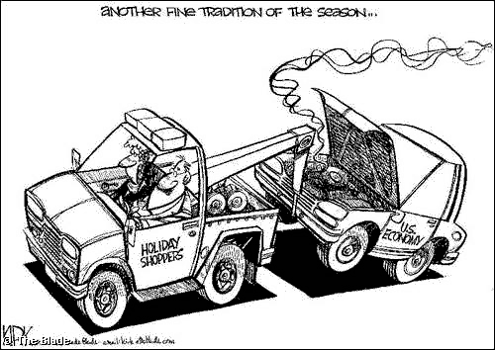
How does this cartoon relate to Aggregate Demand?

Slide 11
What is Aggregate Supply?
Aggregate Supply is the amount of goods and services (real GDP) that firms will produce in an economy at different price levels.
The supply for everything by all firms.
Aggregate Supply differentiates between short run and long-run and has two different curves.
Short-run Aggregate Supply
  Wages and Resource Prices will not increase as price levels increase.
Long-run Aggregate Supply
  Wages and Resource Prices will increase as price levels increase.

Slide 12
Short-Run Aggregate Supply
In the Short Run, wages and resource prices will NOT increase as price levels increase.
Example:
  If a firm currently makes 100 units that are sold for $1 each. The only cost is $80 of labor.
  How much is profit?
  Profit = $100 - $80 = $20
What happens in the SHORT-RUN if price level doubles?
  Now 100 units sell for $2, TR=$200.
  How much is profit?
  Profit = $120
With higher profits, the firm has the incentive to increase production.

Slide 13
Aggregate Supply Curve
Price
Level
AS
AS is the production of all the firms in the economy
Real domestic output (GDP_{R})
13

Slide 14
Long run Aggregate Supply
In Long Run, price level increases but GDP doesn’t
LRAS
Price level
Long-run
Aggregate
Supply
Full-Employment
(Trend Line)
Q_{Y}
GDP_{R}
We also assume that in the long run the economy will be producing at full employment.

Slide 15

Shifters Aggregate Supply
I. R. A. P.

Slide 16

Shifts in Aggregate Supply
An increase or decrease in national production can shift the curve right or left
Price
Level
AS₂
AS
AS₁
Real domestic output (GDP_{R})
16

Slide 17
Shifters of Aggregate Supply
Change in Inflationary Expectations
If an increase in AD leads people to expect higher prices in the future. This increases labor and resource costs and decreases AS.
(If people expect lower prices…)
2. Change in Resource Prices
  Prices of Domestic and Imported Resources
  (Increase in price of Canadian lumber…)
  (Decrease in price of Chinese steel…)
  Supply Shocks
  (Negative Supply shock…)
  (Positive Supply shock…)
17

Slide 18
Shifters of Aggregate Supply
Change in Actions of the Government
(NOT Government Spending!!!!!!!!)
Taxes on Producers
(Lower corporate taxes…)
Subsides for Domestic Producers
(Lower subsidies for domestic farmers…)
Government Regulations
(EPA inspections required [regulations] to operate a farm…)
Change in Productivity
  Technology
  (Computer virus that destroys half of all computers…)
  (The advent of a teleportation machine…)
18

Slide 19
Practice
19

Slide 20

Putting AD and AS together to get
Equilibrium Price Level and Output

Slide 21
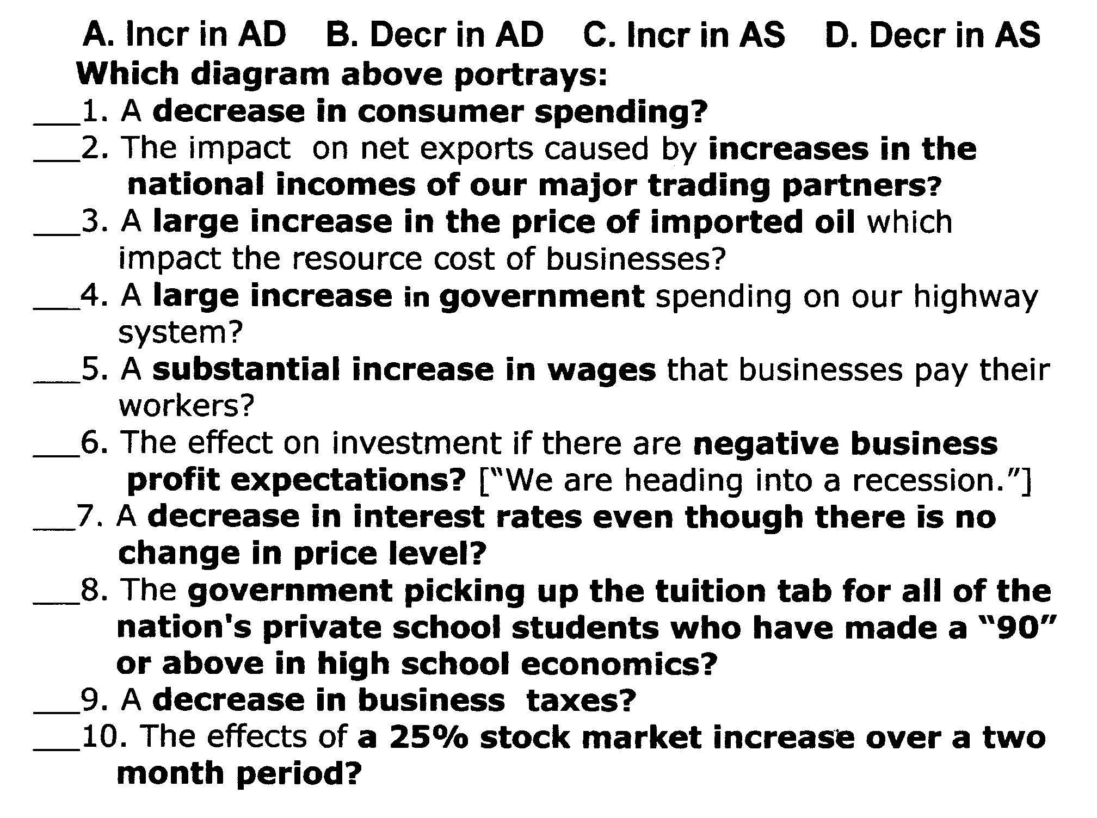
Answer and identify shifter: C.I.G.X or i.R.A.P
A major increase in productivity.
21

Slide 22
Inflationary and Recessionary Gaps
22

Slide 23
Example: Assume the government increases spending. What happens to PL and Output?
LRAS
Price Level
AS
PL and Q will Increase
PL₁
PL_{e}
AD₁
AD
Q_{Y}
Q₁
GDP_{R}
23

Slide 24
Inflationary Gap
Output is high and unemployment is less than NRU
LRAS
Price Level
AS
Actual GDP above potential GDP
PL₁
AD₁
Q_{Y}
Q₁
GDP_{R}
24

Slide 25
Example: Assume the price of oil increases drastically. What happens to PL and Output?
LRAS
Price Level
AS₁
AS
PL₁
Stagflation
Stagnate Economy + Inflation
PL_{e}
AD
Q₁
Q_{Y}
GDP_{R}
25

Slide 26
Recessionary Gap
Output low and unemployment is more than NRU
LRAS
Price Level
AS₁
Actual GDP below potential GDP
PL₁
AD
Q₁
Q_{Y}
GDP_{R}
26

Slide 27
AD and AS Practice Worksheet
27

Slide 28
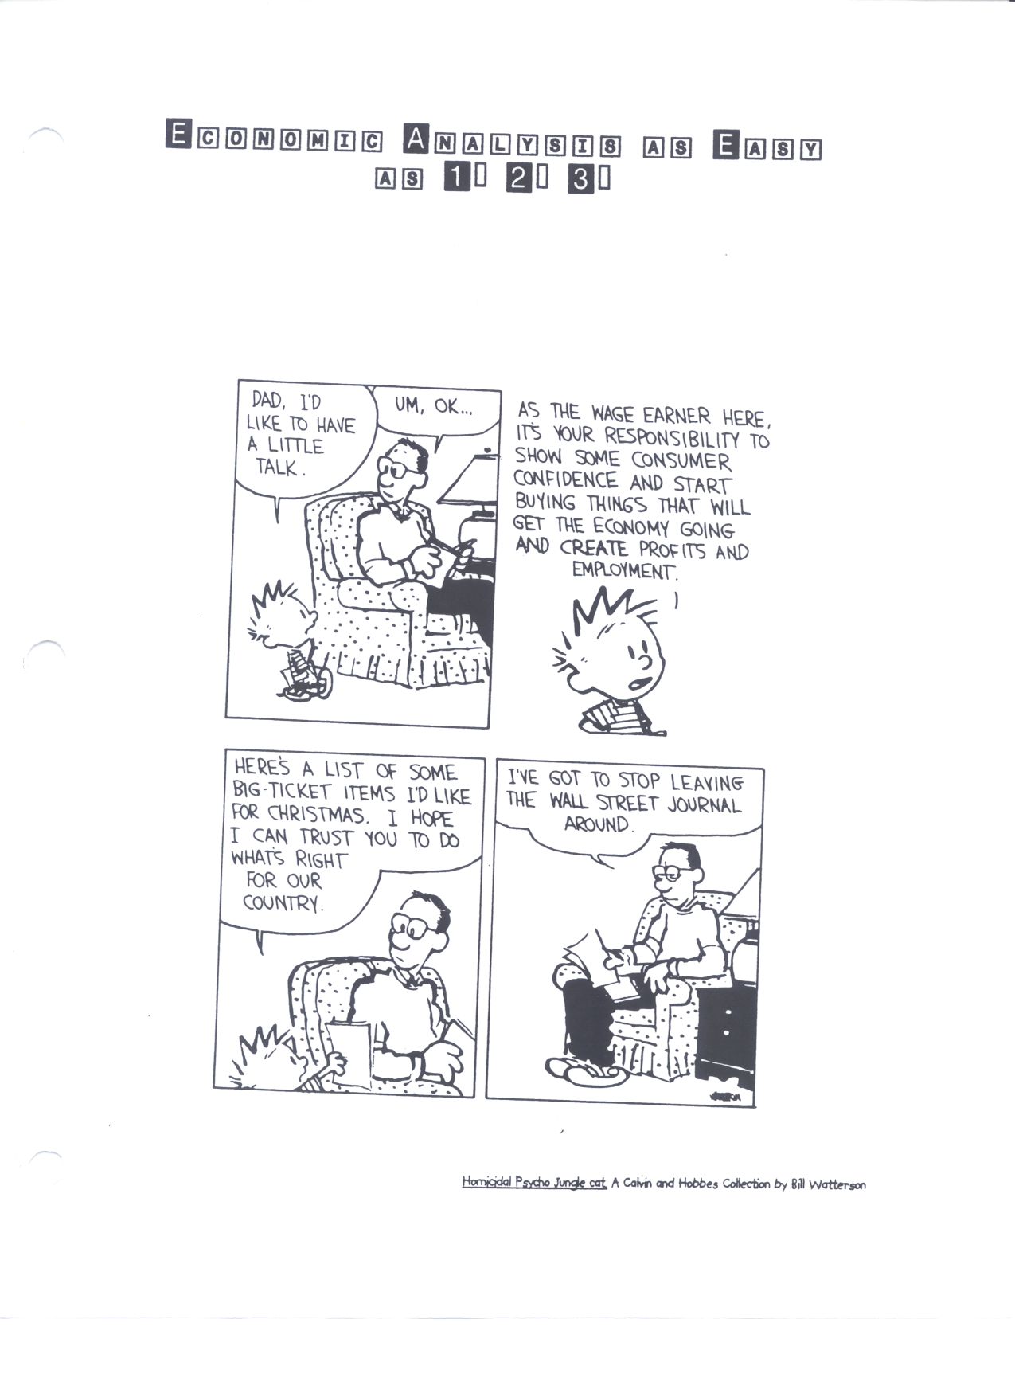
How does this cartoon relate to Aggregate Demand?
28

Slide 29
Draw AD and AS at full employment
LRAS
Price Level
AS
P₂
P₁
AD₂
AD=C+I+G+X
Q_{f}
(Y*or FE)
Q₂
GDP_{R}
Output Increases
PL Increases
29

Slide 30
Short Run and
Long Run
30

Slide 31
Shifts in AD or AS change the price level and output in the short run
LRAS
Price Level
AS
PL_{e}
AD
Q_{Y}
GDP_{R}
31

Slide 32
Example: Assume consumers increase spending. What happens to PL and Output?
LRAS
Price Level
AS
PL₁
PL_{e}
AD₁
AD
Q_{Y}
Q₁
GDP_{R}
32

Slide 33
Now, what will happen in the LONG RUN?
Inflation means workers seek higher wages and production costs increase
LRAS
Price Level
AS₁
AS
PL₂
Back to full employment with higher price level
PL₁
PL_{e}
AD₁
AD
Q_{Y}
Q₁
GDP_{R}
33

Slide 34
Example: Consumer expectations fall and consumer spending plummets. What happens to PL and Output in the Short Run and Long Run?
Price Level
LRAS
AS
AS₁
AS increases as workers accept lower wages and production costs fall
PL_{e}
PL₁
PL₂
AD
AD
AD₁
Q₁
Q_{Y}
GDP_{R}
34
Notes:
Short Run -AD Falls, PL and Q fall
Long Run- AS Increases as workers accept lower wages and production costs fall. PL goes down, Q goes back to Full Employment

Slide 35
Aggregate Demand and Supply and Fiscal Policy
35

Slide 36
The Car Analogy
The economy is like a car…
You can drive 120mph but it is not sustainable. (Extremely Low unemployment)
Driving 20mph is too slow. The car can easily go faster. (High unemployment)
70mph is sustainable. (Full employment)
Some cars have the capacity to drive faster than others. (industrial nations vs. 3rd world nations)
If the engine (technology) or the gas mileage (productivity) increase then the car can drive at even higher speeds. (Increase LRAS)
The government’s job is to brake or speed up when needed as well as promote things that will improve the engine. (Shift the PPC outward)

Slide 37
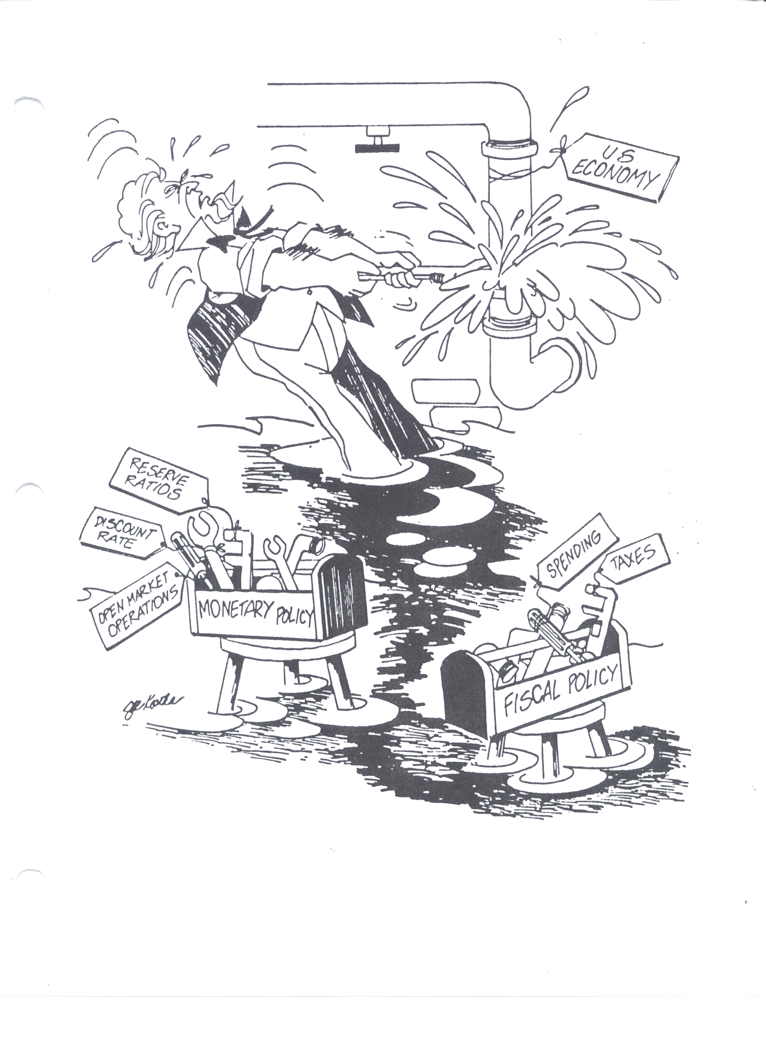
How does the Government Stabilizes the Economy?
The Government has two different tool boxes it can use:
1. Fiscal Policy-
Actions by Congress to stabilize the economy.
OR
2. Monetary Policy-Actions by the Federal Reserve Bank to stabilize the economy.

Slide 38
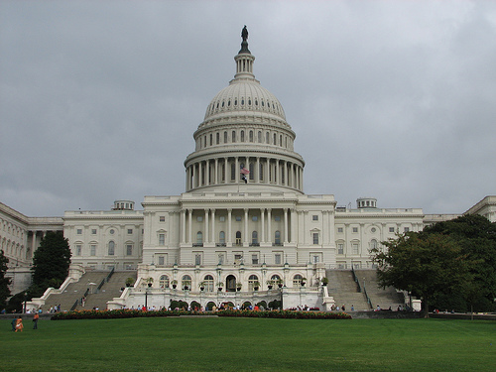
Fiscal Policy

Slide 39
Two Types of Fiscal Policy
Discretionary Fiscal Policy-
  Congress creates a new bill that is designed to change AD through government spending or taxation.
  Problem is time lags due to bureaucracy.
  Takes time for Congress to act.
  Ex: In a recession, Congress increase spending.
Non-Discretionary Fiscal Policy
  AKA: Automatic Stabilizers
  Permanent spending or taxation laws enacted to work counter cyclically to stabilize the economy
  Ex: Welfare, Unemployment, Min. Wage, etc.
  When there is high unemployment, unemployment benefits to citizens increase consumer spending.
39

Slide 40
Discretionary Fiscal Policy
40

Slide 41
Contractionary Fiscal Policy (The BRAKE)
Laws that reduce inflation, decrease GDP (Close a Inflationary Gap)
Decrease Government Spending
Tax Increases
Combinations of the Two
Expansionary Fiscal Policy (The GAS)
Laws that reduce unemployment and increase GDP (Close a Recessionary Gap)
Increase Government Spending
Decrease Taxes on consumers
Combinations of the Two
How much should the Government Spend?
41

Slide 42
Non-Discretionary Fiscal Policy
42

Slide 43
Non-Discretionary Fiscal Policy
Legislation that act counter cyclically without explicit action by policy makers.
AKA: Automatic Stabilizers
The U.S. Progressive Income Tax System acts counter cyclically to stabilize the economy.
When GDP is down, the tax burden on consumers is low, promoting consumption, increasing AD.
When GDP is up, more tax burden on consumers, discouraging consumption, decreasing AD.
The more progressive the tax system, the greater the economy’s built-in stability.
43

Slide 44
Problems With Fiscal Policy
When there is a recessionary gap what two options does Congress have to fix it?
What’s wrong with combining both?
Deficit Spending!!!!
A Budget Deficit is when the government’s expenditures exceeds its revenue.
The National Debt is the accumulation of all the budget deficits over time.
If the Government increases spending without increasing taxes they will increase the annual deficit and the national debt.
Most economists agree that budget deficits are a necessary evil because forcing a balanced budget would not allow Congress to stimulate the economy.

Slide 45
Additional Problems with Fiscal Policy
Problems of Timing
  Recognition Lag- Congress must react to economic indicators before it’s too late
  Administrative Lag- Congress takes time to pass legislation
  Operational Lag- Spending/planning takes time to organize and execute ( changing taxing is quicker)
Politically Motivated Policies
  Politicians may use economically inappropriate policies to get reelected.
  Ex: A senator promises more welfare and public works programs when there is already an inflationary gap.

Slide 46
Additional Problems with Fiscal Policy
3. Crowding-Out Effect
In basketball, what is “Boxing Out”?
Government spending might cause unintended effects that weaken the impact of the policy.
  Example:
  We have a recessionary gap
  Government creates new public library. (AD increases)
  Now but consumer spend less on books (AD decreases)
  Another Example:
  The government increases spending but must borrow the money (AD increases)
  This increases the price for money (the interest rate).
  Interest rates rise so Investment to fall. (AD decrease)
The government “crowds out” consumers and/or investors

Slide 47
Additional Problems with Fiscal Policy
4. Net Export Effect
  International trade reduces the effectiveness of fiscal policies.
  Example:
We have a recessionary gap so the government spends to increase AD.
The increase in AD causes an increase in price level and interest rates.
U.S. goods are now more expensive and the US dollar appreciates…
Foreign countries buy less. (Exports fall)
Net Exports (Exports-Imports) falls, decreasing AD.

Slide 48
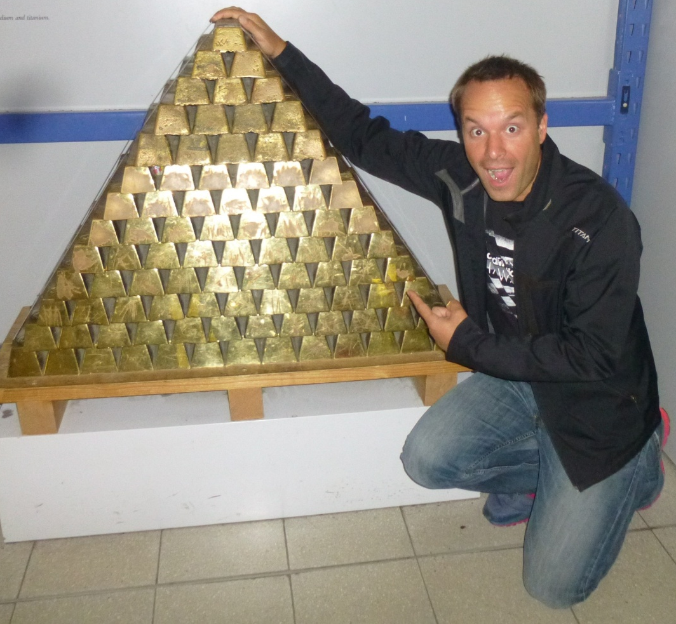
Money
I LOVE GOOOOLD!!!

Slide 49
Why do we use money?
What would happen if we didn’t have money?
The Barter System: goods and services are traded directly. There is no money exchanged.
Problems:
  Before trade could occur, each trader had to have something the other wanted.
  Some goods cannot be split. If 1 goat is worth five chickens, how do you exchange if you only want 1 chicken?
Example: A heart surgeon might accept only certain goods but not others because he doesn’t like broccoli.
To get the surgery, a pineapple grower must find a broccoli farmer that likes pineapples.

Slide 50


What is Money?
Money is anything that is generally accepted in payment for goods and services
Money is NOT the same as wealth or income
Wealth is the total collection of assets that store value
Income is a flow of earnings per unit of time
Commodity Money- Something that performs the function of money and has alternative uses.
  Examples: Gold, silver, cigarettes, etc.
Fiat Money- Something that serves as money but has no other important uses.
  Examples: Paper Money, Coins
50

Slide 51
3 Functions of Money
1. A Medium of Exchange
  Money can easily be used to buy goods and services with no complications of barter system.
2. A Unit of Account
  Money measures the value of all goods and services. Money acts as a measurement of value.
  1 goat = $50 = 5 chickens OR 1 chicken = $10
3. A Store of Value
  Money allows you to store purchasing power for the future.
  Money doesn’t die or spoil.

Slide 52

3 Types of Money
Liquidity- ease with which an asset can be accessed and converted into cash (liquidized)
M1 (High Liquidity) - Coins, Currency, and Checkable deposits (personal and corporate checking accounts).
In general, this is the MONEY SUPPLY
M2 (Medium Liquidity) - M1 plus savings deposits (money market accounts), time deposits (CDs = certificates of deposit), and Mutual Funds below $100K.
M3 (Low Liquidity) - M2 plus time deposits above $100K.

Slide 53
What backs the money supply?
There is no gold standard. Money is just an I.O.U. from the government “for all debts, public and private.”
What makes money effective?
  Generally Accepted - Buyers and sellers have confidence that it IS legal tender.
  Scarce - Money must not be easily reproduced.
  Portable and Dividable - Money must be easily transported and divided.
The Purchasing Power of money is the amount of goods and services any unit of money can buy.
Inflation (increases/decreases) purchasing power.
Rapid inflation (increases/decreases) acceptability.
53

Slide 54
The FED and
Monetary Policy
54

Slide 55

The Money Market
(Supply and Demand for Money)
55

Slide 56

The Supply for Money
The U.S. Money Supply is set by the Board of Governors of the Federal Reserve System (FED)
Interest Rate (ir)
S_{Money}
The FED is a nonpartisan government office that sets and adjusts the money supply to adjust the economy
This is called Monetary Policy.
20%
5%
2%
D_{Money}
200
Quantity of Money
(billions of dollars)

Slide 57
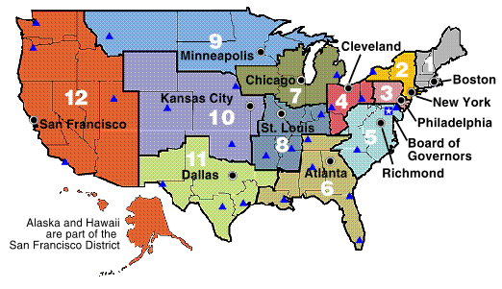
Monetary Policy
When the FED adjusts the money supply to achieve the macroeconomic goals
What is all that stuff on my money?!?
57

Slide 58
Increasing the Money Supply
Interest Rate (ir)
S_{M}
S_{M1}
If the FED increases the money supply, a temporary surplus of money will occur at 5% interest.
The surplus will cause the interest rate to fall to 2%
10%
5%
2%
How does this affect AD?
D_{M}
200
250
Quantity of Money
(billions of dollars)
Increase money supply
Decreases interest rate
Increases investment
Increases AD

Slide 59
Decreasing the Money Supply
Interest Rate (ir)
S_{M1}
S_{M}
If the FED decreases the money supply, a temporary shortage of money will occur at 5% interest.
The shortage will cause the interest rate to rise to 10%
10%
5%
2%
How does this affect AD?
D_{M}
150
200
Quantity of Money
(billions of dollars)
Decrease money supply
Increase interest rate
Decrease investment
Decrease AD
59

Slide 60
Showing the Effects of Monetary Policy Graphically
Three Related Graphs:
Money Market
Investment Demand
AD/AS
60

Slide 61
Interest Rate (i)
S&D of Money
Interest Rate (i)
Investment Demand
S_{M}
S_{M1}
10%
5%
2%
10%
5%
2%
D_{M}
D_{I}
200
250
Quantity_{M}
Quantity of Investment
PL
AD/AS
The FED increases the money supply to stimulate the economy…
AS
PL₁
PL_{e}
Interest Rates Decreases
Investment Increases
AD, GDP and PL Increases
AD
AD₁
Q_{e}
Q₁
GDP_{R}
61

Slide 62
Interest Rate (i)
S&D of Money
Interest Rate (i)
Investment Demand
S_{M1}
S_{M}
10%
5%
2%
10%
5%
2%
D_{M}
D_{I}
175
200
Quantity_{M}
Quantity of Investment
PL
AD/AS
The FED decreases the money supply to slow down the economy…
AS
PL_{e}
Interest Rates increase
Investment decreases
AD, GDP and PL decrease
PL₁
AD
AD₁
Q₁
Q_{e}
GDP_{R}
62

Slide 63
How the FED Stabilizes the Economy
These are the three Shifters of Money Supply
63

Slide 64

3 Shifters of Money Supply
The FED adjusting the money supply by changing any one of the following:
1. Setting Reserve Requirements (Ratios)
2. Lending Money to Banks & Thrifts
    Discount Rate
3. Open Market Operations
    Buying and selling Bonds
The FED is now chaired by Janet Yellen.
I’m YELLEN!!!

Slide 65
#1. The Reserve Requirement
If you have a bank account, where is your money?
Only a small percent of your money is in the safe. The rest of your money has been loaned out.
This is called “Fractional Reserve Banking”
The FED sets the amount that banks must hold
The reserve requirement (reserve ratio) is
the percent of deposits that banks must hold in reserve (the percent they CANNOT loan out)
  When the FED increases the money supply it increases the amount of money held in bank deposits.
  As banks keeps some of the money in reserve and loans out their excess reserves
  The loan eventually becomes deposits for another bank that will loan out their excess reserves.
65

Slide 66
The Money Multiplier
Example: Assume the reserve ratio in the US is 10%
You deposit $1000 in the bank
The bank must hold $100 (required reserves)
The bank lends $900 out to Bob (excess reserves)
Bob deposits the $900 in his bank
Bob’s bank must hold $90. It loans out $810 to Jill
Jill deposits $810 in her bank
SO FAR, the initial deposit of $1000 caused the CREATION of another $1710 (Bob’s $900 + Jill’s $810)
=
1
Money
Multiplier
Reserve Requirement (ratio)
Example:
  If the reserve ratio is .20 and the money supply increases 2 Billion dollars. How will the money supply increase (multiply)?
66
Notes:
10 Billion $$$$

Slide 67
Using Reserve Requirement
1. If there is a recession, what should the FED do to the reserve requirement? (Explain the steps.)
Decrease the Reserve Ratio
  Banks hold less money and have more excess reserves
  Banks create more money by loaning out excess
  Money supply increases, interest rates fall, AD goes up
2. If there is inflation, what should the FED do to the reserve requirement? (Explain the steps.)
Increase the Reserve Ratio
  Banks hold more money and have less excess reserves
  Banks create less money
  Money supply decreases, interest rates up, AD down
67

Slide 68
#2. The Discount Rate
The Discount Rate is the interest rate that the FED charges commercial banks.
Example:
  If Banks of America needs $10 million, they borrow it from the U.S. Treasury (which the FED controls) but they must pay it bank with 3% interest.
To increase the Money supply, the FED should _________ the Discount Rate (Easy Money Policy).
To decrease the Money supply, the FED should _________ the Discount Rate (Tight Money Policy).
68

Slide 69
#3. Open Market Operations
Open Market Operations is when the FED buys or sells government bonds (securities).
This is the most important and widely used monetary policy
To increase the Money supply, the FED should _________ government securities.
To decrease the Money supply, the FED should _________ government securities.
How are you going to remember?
Buy-BIG- Buying bonds increases money supply
Sell-SMALL- Selling bonds decreases money supply
69

Slide 70
International Trade
Why do people trade?
70

Slide 71
Why do people trade?
Assume people didn’t trade. What things would you have to go without?
Everything you don’t produce yourself!
(Clothes, car, cell phone, bananas, heath care, etc)
The Point: Everyone specializes in the production of goods and services and trades it to others
What would life be like if cities couldn’t trade with cities or states couldn’t trade with states?
Limiting trade would reduce people’s choices and make people worse off.
The Point: More access to trade means more choices and a higher standard of living.
71

Slide 72
Absolute and Comparative Advantage
72

Slide 73
Per Unit Opportunity Cost Review
  Per Unit Opportunity Cost
  = Opportunity Cost
  Units Gained
Assume it costs you $50 to produce 5 t-shirts. What is your PER UNIT cost for each shirt?
$10 per shirt
Now, take money our of the equation. Instead of producing 5 shirts you could have made 10 hats.
What is your PER UNIT OPPORTUNITY COST for each shirt in terms of hats given up?
1 shirt costs 2 hats
What is your PER UNIT OPPORTUNITY COST for each hat in terms of shirts given up?
1 hat costs a half of a shirt
73

Slide 74
Per Unit Opportunity Cost Review
Ronald McDonald can produce 20 pizzas or 200 burgers Papa John can produce 100 pizzas or 200 burgers
What is Ronald’s opportunity cost for one pizza in terms of burgers given up?
What is Ronald’s opportunity cost for one burger in terms of pizza given up?
What is Papa John’s opportunity cost for one pizza in terms of burgers given up?
What is Papa John’s opportunity cost for one burger in terms of pizza given up?
1 pizza cost 10 burgers
1 burger costs 1/10 pizza
1 pizza costs 2 burgers
1 burger costs 1/2 pizza
Ronald has a COMPARATIVE ADVANTGE in the production of burgers
Papa John has a COMPARATIVE ADVANTAGE in the production of pizza
74

Slide 75
Absolute and Comparative Advantage
Absolute Advantage
  The producer that can produce the most output OR requires the least amount of inputs (resources)
  Ex: Papa John has an absolute advantage in pizzas because he can produce 100 and Ronald can only make 20.
Comparative Advantage
  The producer with the lowest opportunity cost.
  Ex: Ronald has a comparative advantage in burgers because he has a lowest PER UNIT opportunity cost.
Countries should trade if they have a relatively lower opportunity cost.
They should specialize in the good that is “cheaper” for them to produce.
75

Slide 76
Benefits of Specialize and Trade
76

Slide 77


International Trade
Trade: 1 Wheat for 1.5 Sugar
S | W
0 | 30
1.5 | 29
3 | 28
4.5 | 27
6 | 26
7.5 | 25
9 | 24
10.5 | 23
12 | 22
13.5 | 21
15 | 20
16.5 | 19
18 | 18
19.5 | 17
S | W
20 | 0
18.5 | 1
17 | 2
15.5 | 3
14 | 4
12.5 | 5
11 | 6
9.5 | 7
8 | 8
6.5 | 9
5 | 10
3.5 | 11
USA
Brazil
45
40
35
30
25
20
15
10
5
0
The US Specializes and makes ONLY Wheat
Brazil Makes ONLY Sugar
30
25
20
15
10
5
0
Sugar (tons)
Sugar (tons)
5 10 15 20 25 30
5 10 15 20
Wheat (tons)
Wheat (tons)

Slide 78
International Trade
TRADE SHIFTS THE PPC!
USA
Brazil
45
40
35
30
25
20
15
10
5
0
AFTER TRADE
30
25
20
15
10
5
0
Sugar (tons)
Sugar (tons)
AFTER TRADE
5 10 15 20 25 30
5 10 15 20
Wheat (tons)
Wheat (tons)

Slide 79
Wheat
Sugar
USA
30
(1W costs 1S)
30
(1S costs 1W)
Brazil
10
(1W costs 2S)
20
(1S costs 1/2W)
Which country has a comparative advantage in wheat?
45
40
35
30
25
20
15
Which country should EXPORT Sugar?
Which country should EXPORT Wheat?
Which country should IMPORT Wheat?
30
25
20
15
10
Sugar (tons)
Sugar (tons)
5 10 15 20 25 30
5 10 15 20
Wheat (tons)
Wheat (tons)

Slide 80
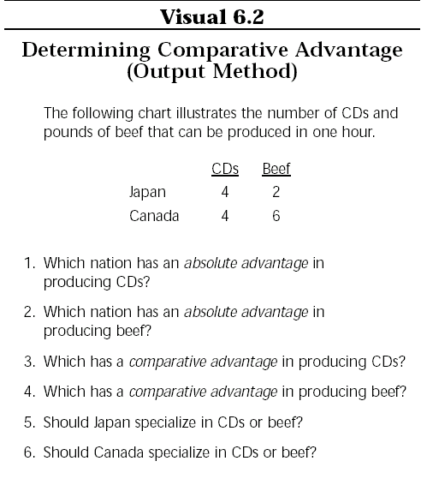
Output Questions:
OOO=
Output: Other goes Over
Notes:
Answers:
Neither
Canada
Japan
Canada
CDs
Beef

Slide 81
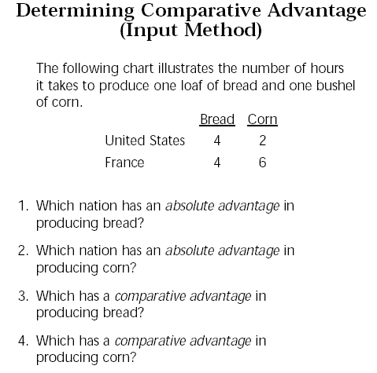
Input Questions:
IOU=
Input: Other goes Under
Notes:
Answers
Both
U.S. (Input Question)
France
Corn

Slide 82
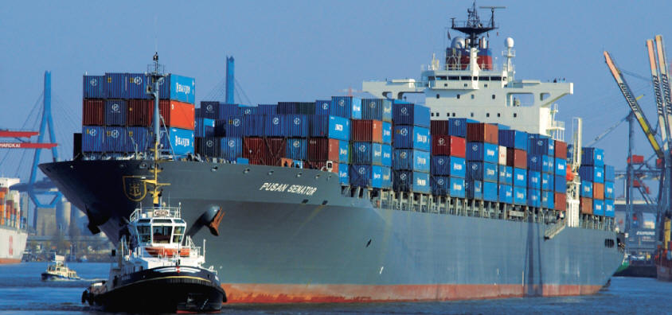
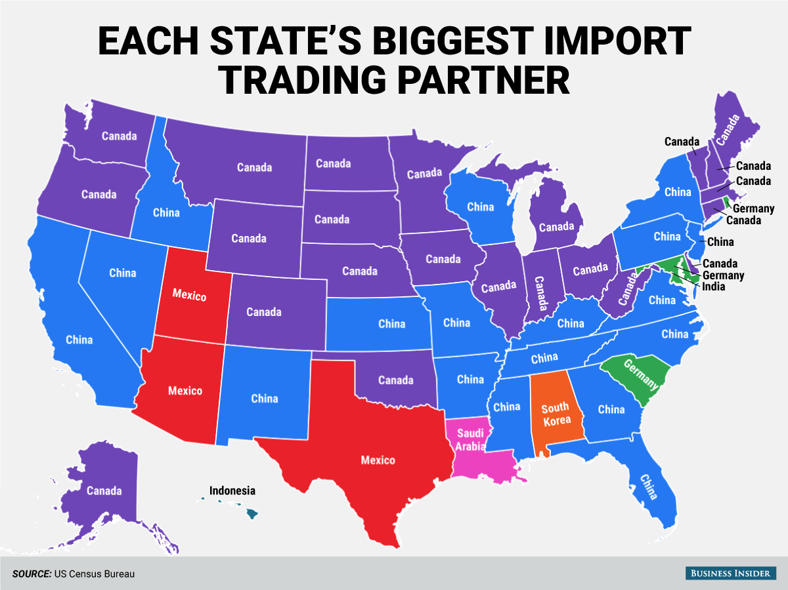
International Trade
82

Slide 84
Closed vs. Open Economies
A closed economy focuses only on the domestic price and the open economy trades for the lower world price.
84
Notes:
Export Goods & Services 16% of American GDP.
US Exports have doubled as a percent of GDP since 1975.
WHY DO WE TRADE!!! What are some reasons?!

Slide 85
Closed vs. Open Economies
A closed economy focuses only on the domestic price and the open economy trades for the lower world price.
85
Notes:
Export Goods & Services 16% of American GDP.
US Exports have doubled as a percent of GDP since 1975.

Slide 86
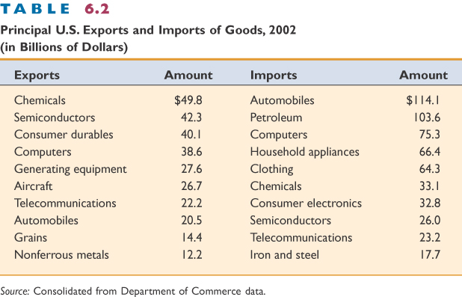
Balance of Trade
Net Exports (X_{N}) = Exports – Imports
Trade Surplus = Exporting more than is imported
Trade Deficit (aka. trade gap) = Exporting less than is imported

Slide 87
Who wins and loses with trade?

Slide 88
Supply and Demand Review
P
S
CS
P_{c}
PS
D
Q_{e}
Q

Slide 89
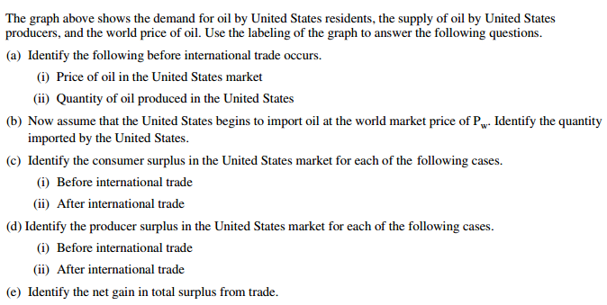
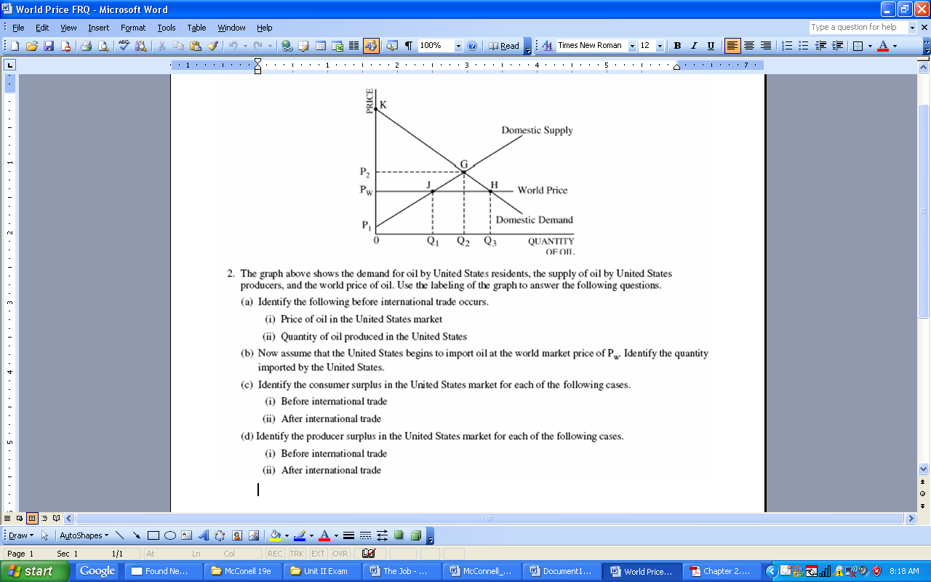
Who benefits from trade?
Who loses?
Is total benefit bigger or smaller with trade?
Notes:
A i. P2
A ii. Q2
B. Q3 – Q1
Ci. KGP2
Cii.KHPw
Di. P1P2G
Dii.P1 Pw J (smaller)
E. I would say Q3-Q1 or G, J, H (area of this triangle is the benefit gained)
Consumers
Domestic Producers
Greater with trade (by area GHJ)

Slide 90

Import Quotas
A quota is a limit on number of imports.
The government sets the maximum amount that can come in the country.
Purpose:
To protect domestic producers from a cheaper world price.
To prevent domestic unemployment

Slide 91
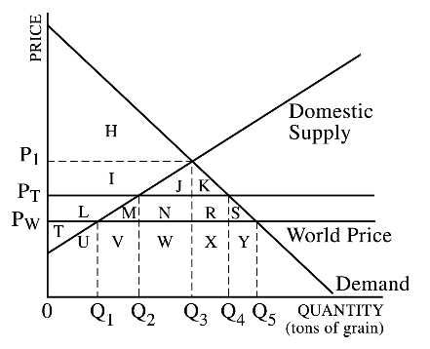
International Trade and Quotas
Identify the following:
CS with no trade
PS with no trade
CS if we trade at world price (P_{W})
PS if we trade at world price (P_{W})
Amount we import at world price (P_{W})
If the government sets a quota on imports of Q₄ - Q_{2,} what happens to CS and PS?
What does this tell us about free trade?
This graphs shows the domestic supply and demand for grain. The letters represent area.
Notes:
1.H
2.TLI
3.HIJKLMNRS
4.T
5.Q5-Q1
6. CS gets smaller and PS gets bigger
In 1900 40% of workforce worked in agriculture. By 2011 only 1% of workforce worked in agriculture.

