Slide 1
MACRO
ECONOMICS

Slide 2
What is Macroeconomics?
Macroeconomics is the study of the large economy as a whole. It is the study of the big picture.
  Instead of analyzing one consumer, we analyze everyone.
  Instead of one business we study all businesses.
Why study the whole economy?
The field of macroeconomics was born during the Great Depression.
Government didn’t understand how to fix a depressed economy with 25% unemployment.
Macro was created to:
  Measure the health of the whole economy.
  Guide government policies to fix problems.

Slide 3
For all countries there are three major economic goals:
  Promote Economic Growth
  Limit Unemployment
  Keep Prices Stable (Limit Inflation)
In this unit we will analyze how each of these are measured.

Slide 4

Goal #1
Promote Economic Growth
How does a country measure
economic growth?

Slide 5
How do we know how well the economy is doing?
Economists collect statistics on production, income, investment, and savings.
This is called national income accounting.
The most important measure of growth is GDP.
Gross Domestic Product (GDP) is the dollar value of all final goods and services produced within a country’s borders in one year.
    Dollar value- GDP is measured in dollars.
    Final Goods-GDP does not include the value of intermediate goods. Intermediate goods are goods used in the production of final goods and services.
    One Year-GDP measures annual economic performance.

Slide 6
What does GDP tell us?
Just like calculating your own income, GDP measures how well the U.S. is doing financially.
How do you use GDP?
  Compare to previous years (Is there growth?)
  Compare policy changes (Did a new policy work?)
  Compare to other countries (Are we better off?)
*CIA 2007 Estimate

Slide 7
How can you measure growth from year to year?
% Change
in GDP
Year 2 - Year 1
=
X 100
Year 1
Mordor’s GDP in 2007 was $4000
Mordor’s GDP in 2008 was $5000
What is the % Change in GDP?
Hogwart’s GDP in 2007 was $2,000
Hogwart’s GDP in 2008 was $2,100
What is the % Change in GDP?
7
Notes:
25%
5%

Slide 8
What is NOT included in GDP?
Intermediate Goods
  No Multiple Counting, Only Final Goods
    EX: Price of finished car, not the radio, tire, etc.
2. Nonproduction Transactions
  Financial Transactions (nothing produced)
    Ex: Stocks, bonds, Real estate
  Used Goods
    Ex: Old cars, used clothes
3. Non-Market (Illegal) Activities
    Ex: Illegal drugs, unpaid work

Slide 9
How do we calculate GDP?
Four components of GDP:
Consumer Spending
  Ex: $5 Little Caesar's Pizza
Investments -When businesses put money back into their own business.
  Ex: Machinery or tools
Government Spending
  Ex: Bombs or tanks, NOT social security
Net Exports -Exports (X) – Imports (M)
Ex: Value of 3 Ford Focuses minus 2 Hondas
GDP = C + I + G + X_{n}

Slide 10
Practice Calculating GDP

Slide 11
Included or not Included in GDP?
For each situation, identify if it is included in GDP the identify the category C, I, G, or X_{n}
$10.00 for movie tickets
$5M Increase in defense expenditures
$45 for used economics textbook
Ford makes new $2M factory
$20K Toyota made in Mexico
$10K Profit from selling stocks
$15K car made in US, sold in Canada
$10K Tuition to attend college
$120 Social Security payment to Bob
Farmer purchases new $100K tractor

Slide 12
1) You mow your lawn.
2) Your little brother mows the neighbor’s lawn for $10.
3) Boeing (US company) buys steel from a Michigan steel company to make planes.
4) Amanda buys fabric from Wal-Mart to make curtains.
5) John buys a new house.
6) Government buys 10,000 rifles from Colt (US company).
7) You buy 500 shares of Microsoft.
8) You hire a broker to buy 500 shares of Microsoft.
9) Government gives grandma $250 social security check.

Slide 13

Nominal GDP vs. Real GDP

Slide 14
The Problem with GDP
If a country’s GDP increased from $4 Billion to $5 Billion in one year, is the country experiencing economic growth?
Did the country definitely produce 25% more products?
What is Inflation?
A rising general level of prices
EX: If apples are the only thing being produced
Year 1: 10 apples at $1 each; GDP = $10
Year 2: 10 apples x $1.25; GDP = $12.50
GDP is rising, but country is worse off!

Slide 15
Real vs. Nominal GDP
Nominal GDP is evaluated at current market prices.
Real GDP measures the value of economic output (GDP) adjusted for price changes (i.e., inflation or deflation).
Real GDP adjusts for inflation.
REAL GDP IS THE BEST MEASURE OF ECONOMIC GROWTH!

Slide 16
Real vs. Nominal GDP Example
2008
10 cars at $15,000 each = $150,000
10 trucks at $20,000 each = $200,000
Nominal GDP = $350,000
The GDP in year 20048 shows the dollar value of all final goods produced.
The nominal GDP in year 2009 is higher which suggests that the economy is improving.
But how much is the REAL GDP? How do you get it?
2009
10 cars at $16,000 each = $160,000
10 trucks at $21,000 each= $210,000
Nominal GDP = $370,000
2009
10 cars at $15,000 each = $150,000
10 trucks at $20,000 each= $200,000
REAL GDP = $350,000
Use 2008 Prices.
The Real GDP for 2009 is the same as 2008 after we adjust for inflation.

Slide 17
Does GDP accurately measure standard of living?
Standard of living (or quality of life) can be measured, in part, by how well the economy is doing…
But it needs to be adjusted to reflect the size of the nation’s population.
Real GDP per capita (per person)
Real GDP per capita is real GDP divided by the total population. It identifies on average how many products each person makes.
Real GDP per capita is the best measure of a nation’s standard of living.

Slide 18
Why do some countries have higher GDPs than others?
  Productivity (TECHN)
1. Technology
2. Economic System
  Example#1: Capitalist countries have historically had more economic growth.
  Capital (like robots) can produce more than people
  Countries with more capital, can produce more products than countries without a lot of capital.
3. Capital
  Ex: Capital stock is machinery, tools, and man-made resources.
  Example#1: India has over a billion people (human resources) but relatively few capital resources and therefore a lower GDP than the U.S.
  Example#2: Japan has few natural resources but a high GDP
4. Human Capital (Knowledge)
5. Natural Resources
  Ex: Syria has a lower GDP because it is mostly desert.

Slide 19

THE BUSINESS CYCLE

Slide 20

Define Macroeconomics
What are the 3 economic goals that all countries have
Identify the 3 key parts of the definition of GDP
How do we use GDP
Identify what is NOT included in GDP
List the 4 components of GDP
Define Inflation
Explain the difference between Nominal and Real GDP
Explain the usefulness of Real GDP per Capita
Name 10 horror films

Slide 21
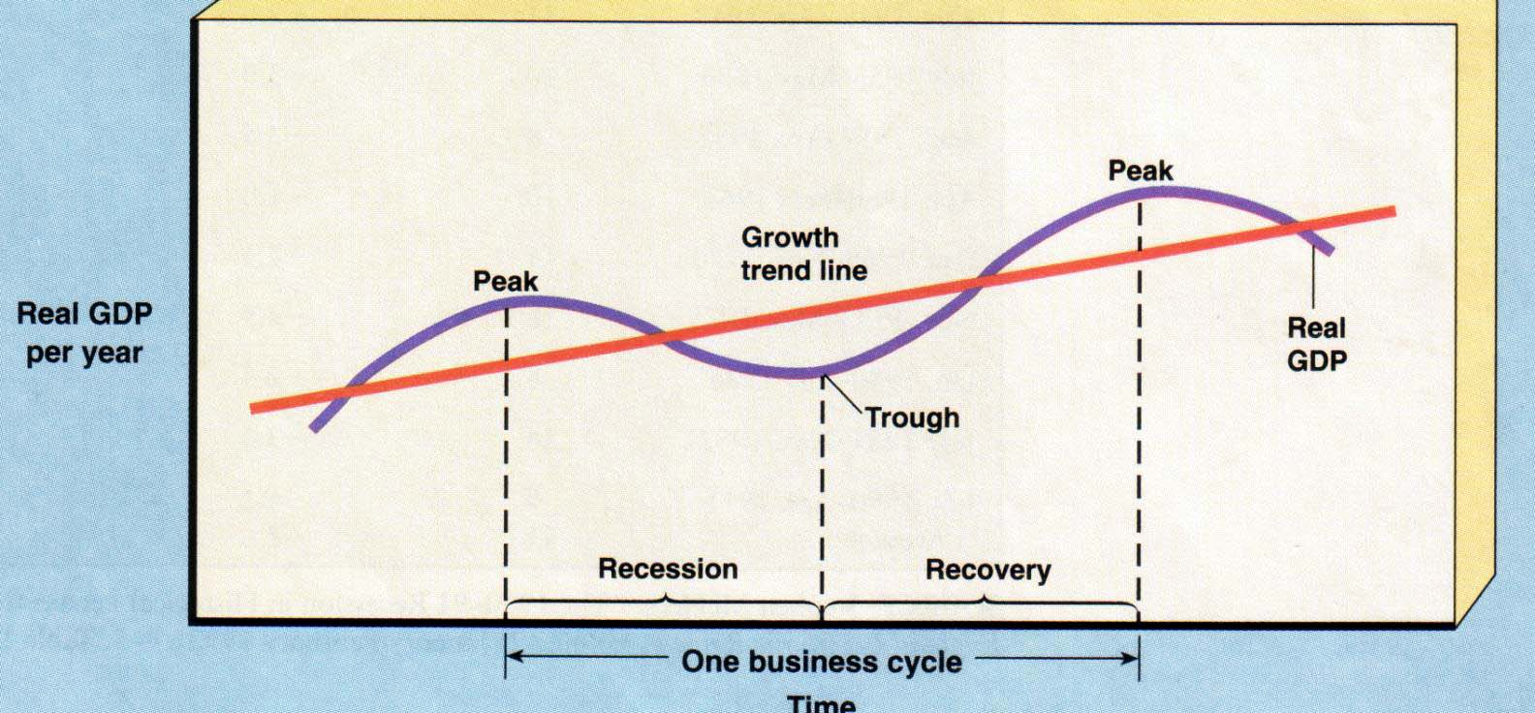
THE BUSINESS CYCLE
The national economy fluctuates resulting in periods of boom and bust.
Inflation
Unemployment
Full employment
A Recession is 6 month period of decline in output, income, employment, and trade. (If really bad…then depression)

Slide 22
The Business Cycle
Why does the economy fluctuate?
Retailer and Producers send misleading information about consumer demand.
Advances in tech, productivity, or resources.
Outside influences (wars, supply shocks, panic).
Who cares?
Macroeconomics measures these fluctuations and guides policies to keep the economy stable.
The government has the responsibility to:
  Promote long-term growth.
  Prevent unemployment (resulting from a bust).
  Prevent inflation (resulting form a boom).

Slide 23
What is Economic Growth?
An increase in real GDP over time
An increase in real GDP per capita over time (usually used to determine standard of living)
Why is economic growth the goal of every society?
Provides better goods and services
Increases wages and standard of living
Allows more leisure time
Economy can better meet wants

Slide 24
Connection to PPC
The same information shown on the business cycle can be shown on a production possibilities curve.
        Full employment
        Unemployment
        Inflation
The shifters of the PPC affect GDP
Change in quantity/quality of resources
Changes in technology
Changes in trade

Slide 25

Goal #2
Limit Unemployment

Slide 26
What is Unemployment?
The Unemployment rate
The percent of people in the labor force who want a job but are not working.
Unemployment
rate
# unemployed
x
=
100
# in labor force
Who is in the Labor Force?
  Above 16 years old
  Able and willing to work
  Not institutionalized (jails, hospitals)
  Not in military, in school full time, or retired
Why is a stay at home mom not unemployed?

Slide 27
Three Types of Unemployment

Slide 28
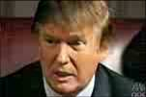
3 Types of Unemployment
#1. Frictional Unemployment
“Temporarily unemployed” or being between jobs.
Individuals are qualified workers with transferable skills but they aren’t working.
Examples:
High school or college graduates looking for jobs.
Individuals that were fired and are looking for a better job.
You’re
Fired!

Slide 29
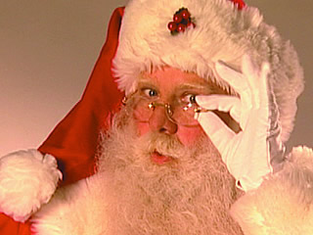

3 Types of Unemployment
Seasonal Unemployment
This is a specific type of frictional unemployment which is due to time of year and the nature of the job.
These jobs will come back
Examples:
Professional Santa Clause Impersonators
Construction workers in Michigan

Slide 30

3 Types of Unemployment
#2. Structural Unemployment
Changes in the structure of the labor force make some skills obsolete.
Workers DO NOT have transferable skills and these jobs will never come back.
Workers must learn new skills to get a job.
The permanent loss of these jobs is called “creative destruction.” (Why?)
Examples:
VCR repairmen
Carriage makers

Slide 31


3 Types of Unemployment
Technological Unemployment
Type of structural unemployment where automation and machinery replace workers causing unemployment
Examples:
Auto assemblers fired as robots take over production
Producers of Capital Goods (tractors) fire assemblers

Slide 32
3 Types of Unemployment
#3 Cyclical Unemployment
Unemployment that results from economic downturns (recessions).
As demand for goods and services falls, demand for labor falls and workers are fired.
Examples:
Steel workers laid off during recessions.
Restaurant owners fire waiters after months of poor sales due to recession.
This sucks!

Slide 33
The Natural Rate of Unemployment
Two of the of the three types of unemployment are unavoidable:
  Frictional unemployment
  Structural unemployment
Together they make up the natural rate of unemployment (NRU).
We are at full employment if we have only the natural rate of unemployment.
This is the normal amount of unemployment that we SHOULD have.
  The number of jobs seekers equals the number of jobs vacancies.

Slide 34
The Natural Rate of Unemployment
Full employment means NO Cyclical unemployment!
Economists generally agree that an unemployment rate of around 4 to 6 % is full employment.
4-6% Unemployment = NRU
Okun’s Law: When unemployment rises 1 percent above the natural rate, GDP falls by about 2 percent

Slide 35
Notes:
35
Unemployment benefits in the U.S. are often extended to 9 months or 1 year during periods of high unemployment.

Slide 36
Government Unemployment Report Number | Who’s Counted | Percent/Rate Reported for June 2009 | Anything Else Interesting?
U4
U5
U6
U3: Official Unemployment Rate

Slide 37
The Natural Rate of Unemployment
The natural rate in France and Germany is around 8–10%. Why?
Some economists attribute the difference to more generous unemployment benefits in European countries
  In the U.S. unemployment benefits last for 6 months
  Unemployment benefits in some European countries are indefinite
  The generous benefits reduce incentives to search for a job
Notes:
37
Unemployment benefits in the U.S. are often extended to 9 months or 1 year during periods of high unemployment.

Slide 38
Criticisms of the Unemployment Rate
What is wrong with the unemployment rate?
It can misdiagnose the actual unemployment rate because of the following:
  Disgruntled job seekers-
    Some people are no longer looking for a job because they have given up.
  Part-Time Workers-
    Someone who wants more shifts but can’t get them is still considered employed.
  Race/Age Inequalities-
    Hispanics – 5.8% for January
    African American- 8.9% for January
    Teenagers- 15.3% for January
  Illegal Labor-
    Many people work under the table.

Slide 39
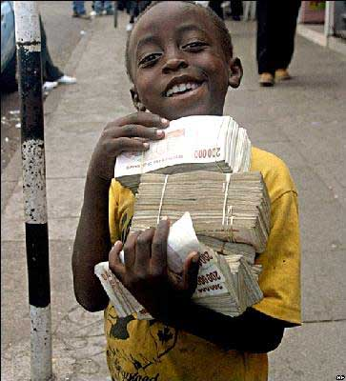
Goal #3
LIMIT INFLATION
Country and Time-
Zimbabwe, 2008
Annual Inflation Rate-
79,600,000,000%
Time for Prices to Double-
24.7 hours

Slide 40

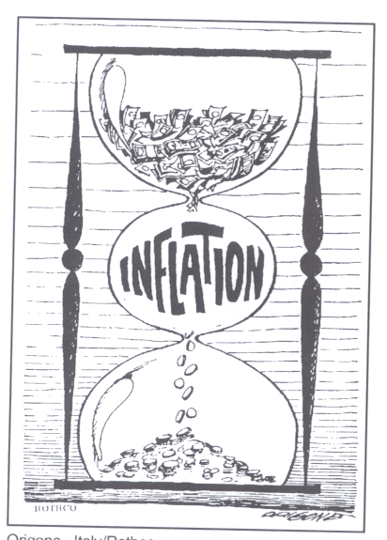
What is Inflation?
Inflation is rising general level of prices
Inflation reduces the “purchasing power” of money
Examples:
  It takes $2 to buy what $1 bought in 1982
  It takes $6 to buy what $1 bought in 1961
When inflation occurs, each dollar of income will buy fewer goods than before.

Slide 41
How is Inflation measured?
The government tracks the prices of the same goods and services each year.
This “market basket” is made up of about 300 (video) commonly purchased goods
The Inflation Rate-% change in prices in 1 year
They also compare changes in prices to a given base year (usually 1982)
Prices of subsequent years are then expressed as a percentage of the base year
Examples:
  2005 inflation rate was 3.4%
  U.S. prices have increase 98.3% since 1982 (base year).
  The inflation rate in Bolivia in 1985 was 50,000%
    This is called Hyperinflation
    A $25 meal today would cost $12,525 a year later

Slide 42
Is Inflation Good or Bad?

Slide 43
Identify which people are helped and which are hurt by unanticipated inflation?
A man who lent out $500 to his friend in 1960 and is still waiting to be paid back.
A tenant who is charged $850 rent each year.
An elderly couple living off fixed retirement payments of $2000 a month
A man that borrowed $1,000 in 1995 and paid it back in 2006
A women who saved a paycheck from 1950 by putting it under her mattress

Slide 44
Make a T-Chart
Hurt by Inflation Helped by Inflation
Cost-of-Living-Adjustment (COLA)
Some works have salaries that mirror inflation.
They negotiated wages that rise with inflation

Slide 45
Measuring Inflation
Consumer Price Index (CPI)

Slide 46
Consumer Price Index (CPI)
The most commonly used measurement inflation for consumers is the Consumer Price Index
Here is how it works:
The base year is given an index of 100
To compare, each year is given an index # as well
Price of market basket
CPI
=
x 100
Price of market
basket in base year
1997 Market Basket: Movie is $6 & Pizza is $14
Total = $20 (Index of Base Year = 100)
2009 Market Basket: Movie is $8 & Pizza is $17
  Total = $25 (Index of )
125
This means inflation increased 25% b/w ’97 & ‘09
Items that cost $100 in ’97 cost $125 in ‘09

Slide 47
Problems with the CPI
Substitution Bias- As prices increase for the fixed market basket, consumers buy less of these products and more substitutes that may not be part of the market basket. (Result: CPI may be higher than what consumers are really paying)
New Products- The CPI market basket may not include the newest consumer products. (Result: CPI measures prices but not the increase in choices)
Product Quality- The CPI ignores both improvements and decline in product quality. (Result: CPI may suggest that prices stay the same though the economic well being has improved significantly)

Slide 48
Calculating Nominal GDP, Real GDP, and Inflation

Slide 49
Calculating CPI
Nominal,
GDP
CPI/ GDP Deflator (Year 1 as Base Year)
Real,
GDP
Inflation Rate
Units of
Output
Price
Per Unit
Year
1
2
3
4
5
10
10
15
20
25
$ 4
5
6
8
4
Make year one the base year
Price of market basket in the particular year
CPI
=
x 100
Price of the same market
basket in base year

Slide 50
Calculating CPI
Nominal,
GDP
CPI/ GDP Deflator (Year 1 as Base Year)
Real,
GDP
Inflation Rate
Units of
Output
Price
Per Unit
Year
1
2
3
4
5
10
10
15
20
25
$ 4
5
6
8
4
Inflation Rate
=
Year 2 - Year 1
% Change
in Prices
X 100
Year 1

Slide 51
Practice
Nominal,
GDP
Units of
Output
Price
Per Unit
Real,
GDP
Consumer Price Index
(Year 3 as Base Year)
Year
1
2
3
4
5
5
10
20
40
50
$ 6
8
10
12
14
Make year three the base year
Price of market basket in the particular year
CPI
=
x 100
Price of the same market
basket in base year

Slide 52

Three Causes of Inflation
If everyone suddenly had a million dollars, what would happen?
What two things cause prices to increase? Use Supply and Demand

Slide 53
3 Causes of Inflation
2. DEMAND-PULL INFLATION
“Too many dollars chasing too few goods”
DEMAND PULLS UP PRICES!!!
Demand increases but supply stays the same. What is the result?
A Shortage driving prices up
An overheated economy with excessive spending but same amount of goods.

Slide 54

3 Causes of Inflation
3. COST-PUSH INFLATION
Higher production costs increase prices
A negative supply shock increases the costs of production and forces producers to increase prices.
Examples:
  Hurricane Katrina destroyed oil refineries and causes gas prices to go up. Companies that use gas increase their prices.

Slide 55
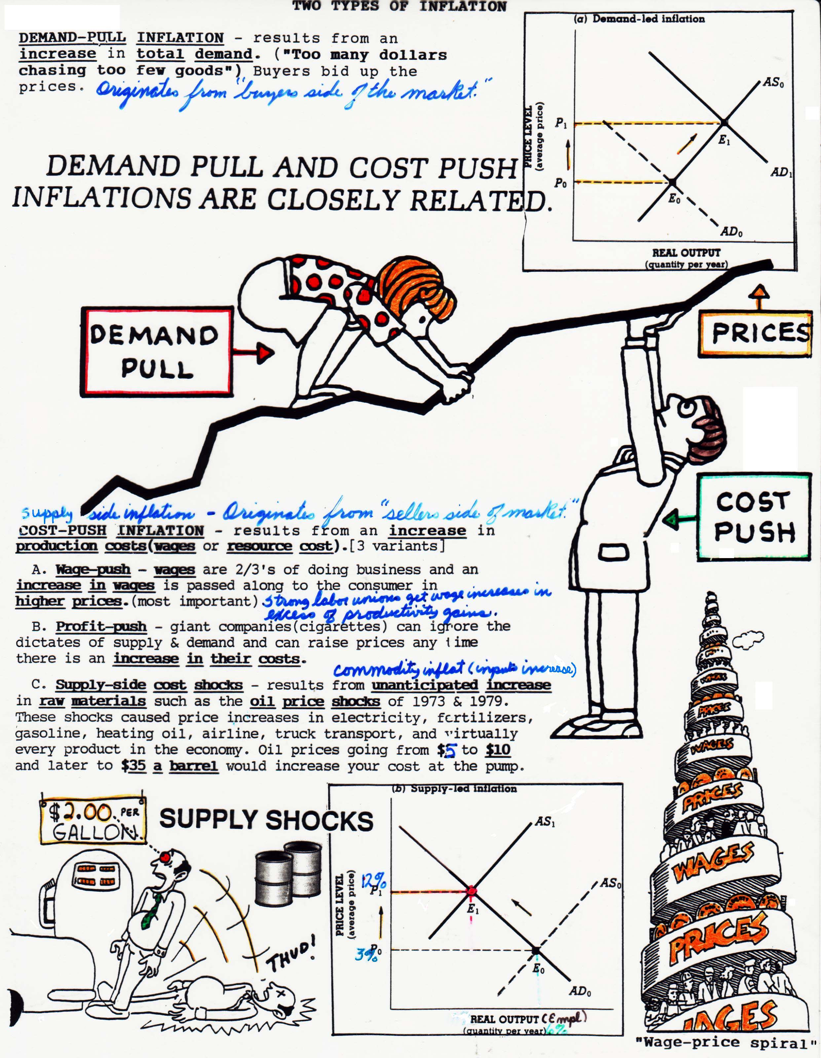
The Wage-Price Spiral
A Perpetual Process:
1.Workers demand raises
2.Owners increase prices to pay for raises
3. High prices cause workers to demand higher raises
4. Owners increase prices to pay for higher raises
5. High prices cause workers to demand higher raises
6. Owners increase prices to pay for higher raises

