Slide 1
Unit 3 Microeconomics:
Supply and Demand

Slide 2

Connection to Circular Flow Model
Do individuals supply or demand?
Do business supply or demand?
Who demands in the product market?
Who supplies in the product market?

Slide 3
DEMAND DEFINED
What is Demand?
Demand is the different quantities of goods that consumers are willing and able to buy at different prices.
  (Ex: Bill Gates is able to purchase a Ferrari, but if he isn’t willing he has NO demand for one)
What is the Law of Demand?
  There is an INVERSE relationship between price and quantity demanded

Slide 4

LAW OF DEMAND
As Price Falls…
…Quantity Demanded Rises
As Price Rises…
…Quantity Demanded Falls
Quantity Demanded
Price

Slide 5
Example of Demand
I am willing to sell several A’s in AP Economics. How much will you pay?
Price | Quantity Demanded
Demand Schedule

Slide 6
Why does the Law of Demand occur?
The law of demand is the result of three separate behavior patterns that overlap:
  The Substitution effect
  The Income effect
  The Law of Diminishing Marginal Utility
  We will define and explain each…

Slide 7
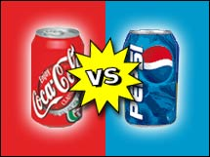
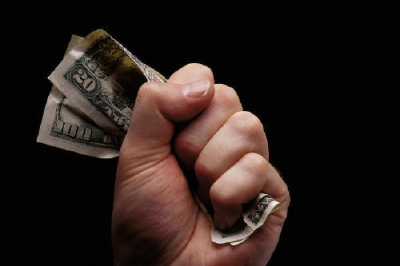
Why does the Law of Demand occur?
1. The Substitution Effect
If the price goes up for a product, consumer buy less of that product and more of another substitute product (and vice versa)
2. The Income Effect
If the price goes down for a product, the purchasing power increases for consumers -allowing them to purchase more.

Slide 8

Why does the Law of Demand occur?
3. Law of Diminishing Marginal Utility
U-
TIL-
IT-
Y
Utility = Satisfaction
We buy goods because we get utility from them
The law of diminishing marginal utility states that as you consume more units of any good, the additional satisfaction from each additional unit will eventually start to decrease
In other words, the more you buy of ANY GOOD the less satisfaction you get from each new unit.
Discussion Questions:
What does this have to do with the Law of Demand?
How does this effect the pricing of businesses?

Slide 9

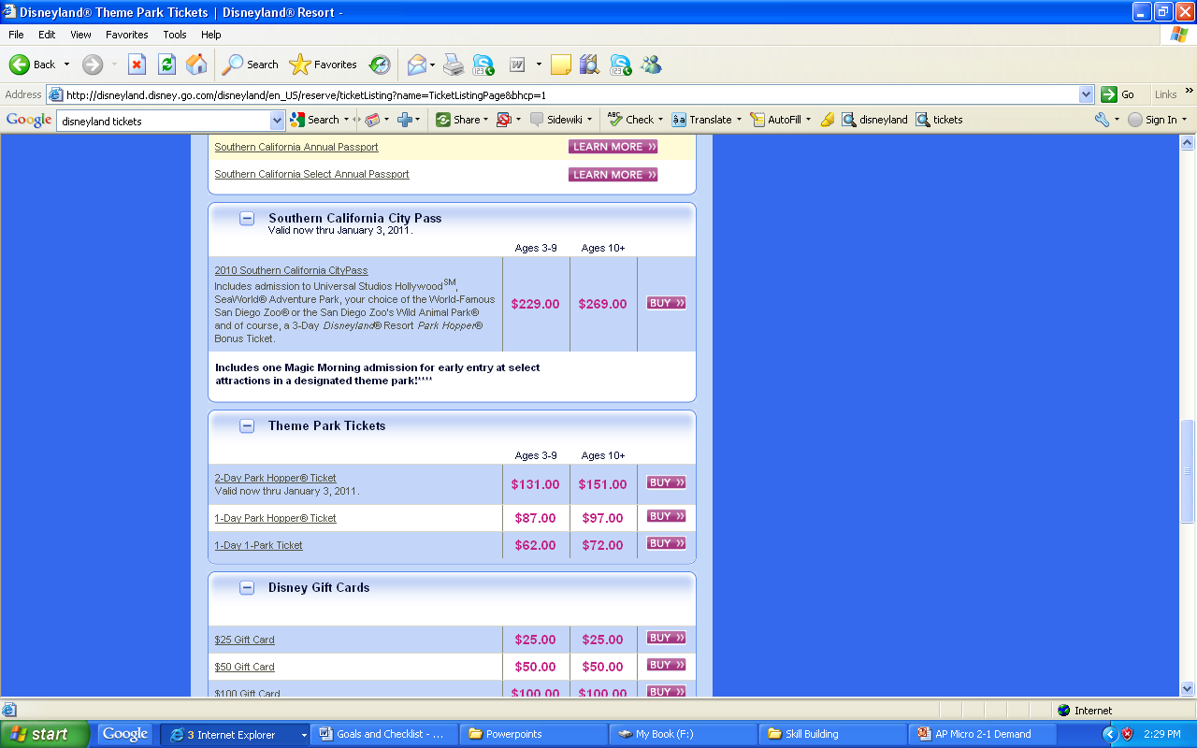
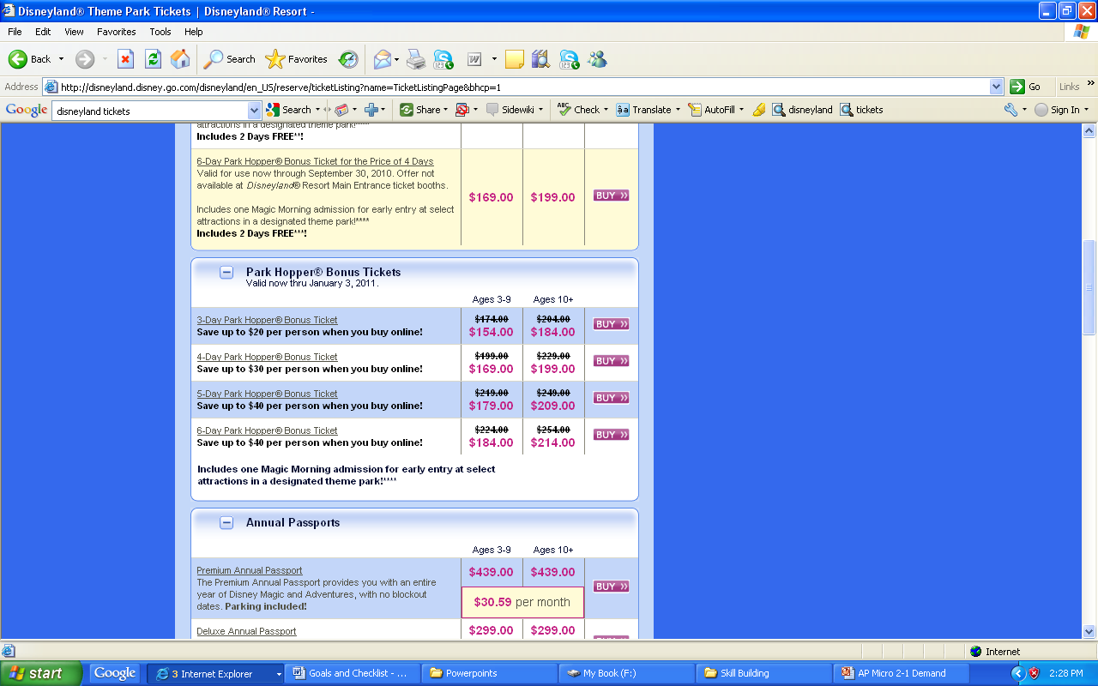
Can you see the Law of Diminishing Marginal Utility in Disneyland’s pricing strategy?
Change
N/A
$54
$33
$15
$10
$5

Slide 10
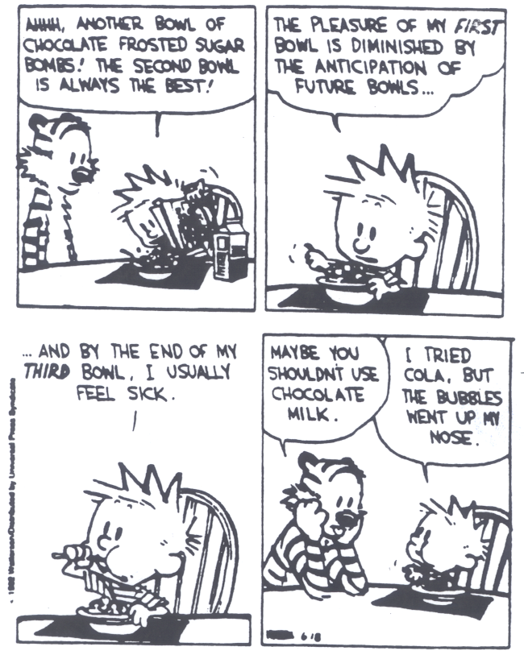
The Law of Diminishing Marginal Utility

Slide 11

Graphing Demand

Slide 12
The Demand Curve
A demand curve is a graphical representation of a demand schedule.
The demand curve is downward sloping showing the inverse relationship between price (on the y-axis) and quantity demanded (on the x-axis)
When reading a demand curve, assume all outside factors, such as income, are held constant. (This is called ceteris paribus)
Let’s draw a new demand curve for cereal…

Slide 13
GRAPHING DEMAND
Demand Schedule
Price of Cereal
Draw this large in your notes
$5
4
3
2
1
Price | Quantity Demanded
$5 | 10
$4 | 20
$3 | 30
$2 | 50
$1 | 80
o
Q
10 20 30 40 50 60 70 80
Quantity of Cereal

Slide 14
GRAPHING DEMAND
Demand Schedule
Price of Cereal
$5
4
3
2
1
Price | Quantity Demanded
$5 | 10
$4 | 20
$3 | 30
$2 | 50
$1 | 80
Demand
o
Q
10 20 30 40 50 60 70 80
Quantity of Cereal
14

Slide 15
Where do you get the Market Demand?
Billy
Jean
Other Individuals
Market
Price | Q Demd
$5 | 1
$4 | 2
$3 | 3
$2 | 5
$1 | 7
Price | Q Demd
$5 | 0
$4 | 1
$3 | 2
$2 | 3
$1 | 5
Price | Q Demd
$5 | 9
$4 | 17
$3 | 25
$2 | 42
$1 | 68
Price | Q Demd
$5 | 10
$4 | 20
$3 | 30
$2 | 50
$1 | 80
P
P
P
P
$3
$3
$3
$3
D
D
D
D
3
Q
2
Q
25
Q
30
Q

Slide 16
Hudsucker Movie Clip
Notice how demand affects supply and vice-versa.
What makes the product more expensive?
Did the entrepreneur know the product would be a success?

Slide 17
Supply and Demand

Slide 18
Shifts in Demand
CHANGES IN DEMAND
Ceteris paribus-“all other things held constant.”
When the ceteris paribus assumption is dropped, movement no longer occurs along the demand curve. Rather, the entire demand curve shifts.
A shift means that at the same prices, more people are willing and able to purchase that good.
This is a change in demand, not a change in quantity demanded

Slide 19
Change in Demand
Demand Schedule
Price of Cereal
$5
4
3
2
1
Price | Quantity Demanded
$5 | 10
$4 | 20
$3 | 30
$2 | 50
$1 | 80
Demand
o
Q
10 20 30 40 50 60 70 80
Quantity of Cereal
19

Slide 20
Change in Demand
Demand Schedule
Price of Cereal
$5
4
3
2
1
Price | Quantity Demanded
$5 | 10
$4 | 20
$3 | 30
$2 | 50
$1 | 80
Demand
o
Q
10 20 30 40 50 60 70 80
Quantity of Cereal
20

Slide 21
Change in Demand
Demand Schedule
Price of Cereal
$5
4
3
2
1
Price | Quantity Demanded
$5 | 10
$4 | 20
$3 | 30
$2 | 50
$1 | 80
Demand
o
Q
10 20 30 40 50 60 70 80
Quantity of Cereal
21

Slide 22
Change in Demand
Demand Schedule
Price of Cereal
$5
4
3
2
1
Price | Quantity Demanded
$5 | 30
$4 | 40
$3 | 50
$2 | 70
$1 | 80 100
Demand
o
Q
10 20 30 40 50 60 70 80
Quantity of Cereal
22

Slide 23
Change in Demand
Demand Schedule
Price of Cereal
Increase in Demand
Prices didn’t change but people want MORE cereal
$5
4
3
2
1
Price | Quantity Demanded
$5 | 30
$4 | 40
$3 | 50
$2 | 70
$1 | 80 100
D₁
Demand
o
Q
10 20 30 40 50 60 70 80
Quantity of Cereal
23

Slide 24
Change in Demand
Demand Schedule
Price of Cereal
$5
4
3
2
1
Price | Quantity Demanded
$5 | 10
$4 | 20
$3 | 30
$2 | 50
$1 | 80
Demand
o
Q
10 20 30 40 50 60 70 80
Quantity of Cereal
24

Slide 25
Change in Demand
Demand Schedule
Price of Cereal
$5
4
3
2
1
Price | Quantity Demanded
$5 | 10
$4 | 20
$3 | 30
$2 | 50
$1 | 80
Demand
o
Q
10 20 30 40 50 60 70 80
Quantity of Cereal
25

Slide 26
Change in Demand
Demand Schedule
Price of Cereal
$5
4
3
2
1
Price | Quantity Demanded
$5 | 10
$4 | 20
$3 | 30
$2 | 50
$1 | 80
Demand
o
Q
10 20 30 40 50 60 70 80
Quantity of Cereal
26

Slide 27
Change in Demand
Demand Schedule
Price of Cereal
$5
4
3
2
1
Price | Quantity Demanded
$5 | 0
$4 | 5
$3 | 20
$2 | 30
$1 | 80 60
Demand
o
Q
10 20 30 40 50 60 70 80
Quantity of Cereal
27

Slide 28
Change in Demand
Demand Schedule
Price of Cereal
$5
4
3
2
1
Decrease in Demand
Prices didn’t change but people want LESS cereal
Price | Quantity Demanded
$5 | 0
$4 | 5
$3 | 20
$2 | 30
$1 | 80 60
D₂
Demand
o
Q
10 20 30 40 50 60 70 80
Quantity of Cereal
28

Slide 29
Change in Demand
Demand Schedule
Price of Cereal
$5
4
3
2
1
Price | Quantity Demanded
$5 | 10
$4 | 20
$3 | 30
$2 | 50
$1 | 80
Demand
o
Q
10 20 30 40 50 60 70 80
Quantity of Cereal
29

Slide 30
What Causes a Shift in Demand?
5 Shifters (Determinates) of Demand:
  Tastes and Preferences
  Number of Consumers
  Price of Related Goods
  Income
  Future Expectations
Changes in PRICE don’t shift the curve. It only causes movement along the curve.

Slide 31
Prices of Related Goods
The demand curve for one good can be affected by a change in the price of ANOTHER related good.
Substitutes are goods used in place of one another.
  If the price of one increases, the demand for the other will increase (or vice versa)
  Ex: If price of Pepsi falls, demand for coke will…
2. Complements are two goods that are bought and used together.
  If the price of one increase, the demand for the other will fall. (or vice versa)
  Ex: If price of skis falls, demand for ski boots will...

Slide 32
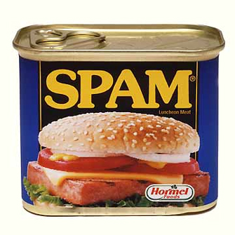




Income
The incomes of consumer change the demand, but how depends on the type of good.
Normal Goods
  As income increases, demand increases
  As income falls, demand falls
  Ex: Luxury cars, Sea Food, jewelry, homes
2. Inferior Goods
  As income increases, demand falls
  As income falls, demand increases
  Ex: Top Ramen, used cars, used clothes,
Notes:
Spam-Inferior
Yachts- Normal
Off Brand Cereal-Inferior
McDonald’s-Inferior
Toilet Paper- Probably no connection to income (The point-some products are very reliant on income and others are not)

Slide 33
Change in Qd vs. Change in Demand
There are two ways to increase quantity from 10 to 20
Price of Cereal
P
A to B is a change in quantity demand (due to a change in price)
A to C is a change in demand (shift in the curve)
A
C
$3
$2
B
D₂
D₁
o
Q Cereal
10 20
Quantity of Cereal

Slide 34
Practice
First, identify the determinant (shifter) then decide if demand will increase or decrease
 | Shifter | Increase or Decrease | Left or Right
1
2
3
4
5
6
7
8
Notes:
Number of consumers, increase.
Income, decrease.
Substitutes, decrease.
Price doesn’t shift curve, no change.
Tastes and preferences, decrease.
Expectations, increase.
Complements, decrease.
Price doesn’t shift curve, no change.

Slide 35

Supply and Demand
Can you see me?

Slide 36

Supply

Slide 37
Supply Defined
What is supply?
Supply is the different quantities of a good that sellers are willing and able to sell (produce) at different prices.
What is the Law of Supply?
There is a DIRECT (or positive) relationship between price and quantity supplied.
  As price increases, the quantity producers make increases
  As price falls, the quantity producers make falls.
  Why? Because, at higher prices profit seeking firms have an incentive to produce more.
EXAMPLE: Mowing Lawns

Slide 38
Example of Supply
You own an lawn mower and you are willing to mow lawns.
How many lawns will you mow at these prices?
Price per lawn mowed | Quantity Supplied
Supply Schedule
$1
$5
$20
$50
$100
$1000
38

Slide 39
GRAPHING SUPPLY
Supply Schedule
Price of Cereal
Draw this large in your notes
$5
4
3
2
1
Price | Quantity Supplied
$5 | 50
$4 | 40
$3 | 30
$2 | 20
$1 | 10
o
Q
10 20 30 40 50 60 70 80
Quantity of Cereal
39

Slide 40
GRAPHING SUPPLY
Supply Schedule
Price of Cereal
Supply
$5
4
3
2
1
Price | Quantity Supplied
$5 | 50
$4 | 40
$3 | 30
$2 | 20
$1 | 10
o
Q
10 20 30 40 50 60 70 80
Quantity of Cereal
40

Slide 41
GRAPHING SUPPLY
Supply Schedule
Price of Cereal
Supply
$5
4
3
2
1
Price | Quantity Supplied
$5 | 50
$4 | 40
$3 | 30
$2 | 20
$1 | 10
o
Q
10 20 30 40 50 60 70 80
Quantity of Cereal
41

Slide 42
Change in Supply
Supply Schedule
Price of Cereal
Supply
$5
4
3
2
1
Price | Quantity Supplied
$5 | 50
$4 | 40
$3 | 30
$2 | 20
$1 | 10
o
Q
10 20 30 40 50 60 70 80
Quantity of Cereal
42

Slide 43
Change in Supply
Supply Schedule
Price of Cereal
Supply
$5
4
3
2
1
Price | Quantity Supplied
$5 | 50
$4 | 40
$3 | 30
$2 | 20
$1 | 10
o
Q
10 20 30 40 50 60 70 80
Quantity of Cereal
43

Slide 44
Change in Supply
Supply Schedule
Price of Cereal
Supply
$5
4
3
2
1
Price | Quantity Supplied
$5 | 70
$4 | 60
$3 | 50
$2 | 40
$1 | 10 30
o
Q
10 20 30 40 50 60 70 80
Quantity of Cereal
44

Slide 45
Change in Supply
Supply Schedule
Price of Cereal
Supply
S₂
$5
4
3
2
1
Price | Quantity Supplied
$5 | 70
$4 | 60
$3 | 50
$2 | 40
$1 | 10 30
Increase in Supply
Prices didn’t change but there is MORE cereal produced
o
Q
10 20 30 40 50 60 70 80
Quantity of Cereal
45

Slide 46
Change in Supply
Supply Schedule
Price of Cereal
Supply
$5
4
3
2
1
Price | Quantity Supplied
$5 | 50
$4 | 40
$3 | 30
$2 | 20
$1 | 10
o
Q
10 20 30 40 50 60 70 80
Quantity of Cereal
46

Slide 47
Change in Supply
Supply Schedule
Price of Cereal
Supply
$5
4
3
2
1
Price | Quantity Supplied
$5 | 50
$4 | 40
$3 | 30
$2 | 20
$1 | 10
o
Q
10 20 30 40 50 60 70 80
Quantity of Cereal
47

Slide 48
Change in Supply
Supply Schedule
Price of Cereal
Supply
$5
4
3
2
1
Price | Quantity Supplied
$5 | 50
$4 | 40
$3 | 30
$2 | 20
$1 | 10
o
Q
10 20 30 40 50 60 70 80
Quantity of Cereal
48

Slide 49
Change in Supply
Supply Schedule
Price of Cereal
Supply
$5
4
3
2
1
Price | Quantity Supplied
$5 | 30
$4 | 20
$3 | 10
$2 | 1
$1 | 10 0
o
Q
10 20 30 40 50 60 70 80
Quantity of Cereal
49

Slide 50
Change in Supply
Supply Schedule
Price of Cereal
Supply
$5
4
3
2
1
S₂
Price | Quantity Supplied
$5 | 30
$4 | 20
$3 | 10
$2 | 1
$1 | 10 0
Decrease in Supply
Prices didn’t change but there is LESS cereal produced
o
Q
10 20 30 40 50 60 70 80
Quantity of Cereal
50

Slide 51
Change in Supply
Supply Schedule
Price of Cereal
Supply
$5
4
3
2
1
Price | Quantity Supplied
$5 | 50
$4 | 40
$3 | 30
$2 | 20
$1 | 10
o
Q
10 20 30 40 50 60 70 80
Quantity of Cereal
51

Slide 52
6 Shifters (Determinants) of Supply
Prices/Availability of inputs (resources)
Number of Sellers
Technology
Government Action: Taxes & Subsidies
5. Opportunity Cost of Alternative Production
6. Expectations of Future Profit
Changes in PRICE don’t shift the curve. It only causes movement along the curve.

Slide 53
Supply Practice
First, identify the determinant (shifter) then decide if supply will increase or decrease
 | Shifter | Increase or Decrease | Left or Right
1
2
3
4
5
6
53
Notes:
Number of consumers, increase.
Income, decrease.
Substitutes, decrease.
Price doesn’t shift curve, no change.
Tastes and preferences, decrease.
Expectations, increase.
Complements, decrease.
Price doesn’t shift curve, no change.
53

Slide 54
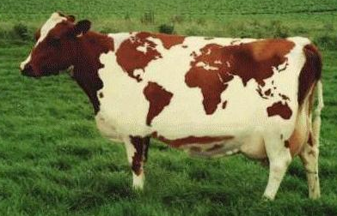
Supply and Demand
Do you see the cow?

Slide 55
Putting Supply and Demand Together!!!

Slide 56
Supply and Demand are put together to determine equilibrium price and equilibrium quantity
P
Supply Schedule
Demand Schedule
S
$5
4
3
2
1
P | Qd
$5 | 10
$4 | 20
$3 | 30
$2 | 50
$1 | 80
P | Qs
$5 | 50
$4 | 40
$3 | 30
$2 | 20
$1 | 10
D
o
Q
10 20 30 40 50 60 70 80
56

Slide 57
Supply and Demand are put together to determine equilibrium price and equilibrium quantity
P
Supply Schedule
Demand Schedule
S
$5
4
3
2
1
P | Qd
$5 | 10
$4 | 20
$3 | 30
$2 | 50
$1 | 80
P | Qs
$5 | 50
$4 | 40
$3 | 30
$2 | 20
$1 | 10
Equilibrium Price = $3 (Qd=Qs)
D
o
Q
10 20 30 40 50 60 70 80
Equilibrium Quantity is 30
57

Slide 58
Supply and Demand are put together to determine equilibrium price and equilibrium quantity
What if the price
increases to $4?
P
Supply Schedule
Demand Schedule
S
$5
4
3
2
1
P | Qd
$5 | 10
$4 | 20
$3 | 30
$2 | 50
$1 | 80
P | Qs
$5 | 50
$4 | 40
$3 | 30
$2 | 20
$1 | 10
D
o
Q
10 20 30 40 50 60 70 80
58

Slide 59
At $4, there is disequilibrium. The quantity demanded is less than quantity supplied.
P
Supply Schedule
Demand Schedule
S
$5
4
3
2
1
Surplus
(Qd<Qs)
P | Qd
$5 | 10
$4 | 20
$3 | 30
$2 | 50
$1 | 80
P | Qs
$5 | 50
$4 | 40
$3 | 30
$2 | 20
$1 | 10
How much is the surplus at $4?
Answer: 20
D
o
Q
10 20 30 40 50 60 70 80
59

Slide 60
How much is the surplus if the price is $5?
What if the price
decreases to $2?
P
Supply Schedule
Demand Schedule
S
$5
4
3
2
1
P | Qd
$5 | 10
$4 | 20
$3 | 30
$2 | 50
$1 | 80
P | Qs
$5 | 50
$4 | 40
$3 | 30
$2 | 20
$1 | 10
Answer: 40
D
o
Q
10 20 30 40 50 60 70 80
60

Slide 61
At $2, there is disequilibrium. The quantity demanded is greater than quantity supplied.
P
Supply Schedule
Demand Schedule
S
$5
4
3
2
1
P | Qd
$5 | 10
$4 | 20
$3 | 30
$2 | 50
$1 | 80
P | Qs
$5 | 50
$4 | 40
$3 | 30
$2 | 20
$1 | 10
How much is the shortage at $2?
Answer: 30
Shortage
(Qd>Qs)
D
o
Q
10 20 30 40 50 60 70 80
61

Slide 62
How much is the shortage if the price is $1?
P
Supply Schedule
Demand Schedule
S
$5
4
3
2
1
P | Qd
$5 | 10
$4 | 20
$3 | 30
$2 | 50
$1 | 80
P | Qs
$5 | 50
$4 | 40
$3 | 30
$2 | 20
$1 | 10
Answer: 70
D
o
Q
10 20 30 40 50 60 70 80
62

Slide 63
The FREE MARKET system automatically pushes the price toward equilibrium.
P
Supply Schedule
Demand Schedule
S
$5
4
3
2
1
When there is a surplus, producers lower prices
P | Qd
$5 | 10
$4 | 20
$3 | 30
$2 | 50
$1 | 80
P | Qs
$5 | 50
$4 | 40
$3 | 30
$2 | 20
$1 | 10
When there is a shortage, producers raise prices
D
o
Q
10 20 30 40 50 60 70 80
63

Slide 64
Shifting Supply and Demand

Slide 65
Supply and Demand Analysis
Easy as 1, 2, 3
Before the change:
  Draw supply and demand
  Label original equilibrium price and quantity
The change:
  Did it affect supply or demand first?
  Which determinant caused the shift?
  Draw increase or decrease
After change:
  Label new equilibrium?
  What happens to Price? (increase or decrease)
  What happens to Quantity? (increase or decrease)
Let’s Practice!

Slide 66
S&D Analysis Practice
Before Change (Draw equilibrium)
The Change (S or D, Identify Shifter)
After Change (Price and Quantity After)
Analyze Hamburgers
  Price of sushi (a substitute) increases
  New grilling technology cuts production time in half
  Price of burgers falls from $3 to $1.
  Price for ground beef triples
  Human fingers found in multiple burger restaurants.
Notes:
1. Demand Increases
2. Supply Increases
3. No Shift. Shortage
4. Supply Decreases
5. Demand Decreases

Slide 67

Double Shifts
Suppose the demand for sports cars fell at the same time as production technology improved.
Use S&D Analysis to show what will happen to PRICE and QUANTITY.
If TWO curves shift at the same time, EITHER price or quantity will be indeterminate.

Slide 68
Voluntary Exchange Terms
Consumer Surplus is the difference between what you are willing to pay and what you actually pay.
CS = Buyer’s Maximum – Price
Producer’s Surplus is the difference between the price the seller received and how much they were willing to sell it for.
PS = Price – Seller’s Minimum

Slide 69
Supply and Demand

Slide 70
Government Involvement
#1-Price Controls: Floors and Ceilings
#2-Subsidies
#3-Excise Taxes

Slide 71
#1-PRICE CONTROLS
Who likes the idea of having a price ceiling on gas so prices will never go over $1 per gallon?

Slide 72
Price Ceiling
Maximum legal price a seller can charge for a product.
Goal: Make affordable by keeping price from reaching Eq.
P
Gasoline
S
$5
4
3
2
1
Does this policy help consumers?
Result: BLACK MARKETS
Price Ceiling
Shortage
(Qd>Qs)
D
o
Q
10 20 30 40 50 60 70 80
72

Slide 73
Price Floor
Minimum legal price a seller can sell a product.
Goal: Keep price high by keeping price from falling to Eq.
P
Corn
S
$
4
3
2
1
Surplus
(Qd<Qs)
Price Floor
Does this policy help corn producers?
D
o
Q
10 20 30 40 50 60 70 80
73

Slide 74
Practice Questions
1. Which of the following will occur if a legal price floor is placed on a good below its free market equilibrium?
Surpluses will develop
Shortages will develop
Underground markets will develop
The equilibrium price will remain the same
The quantity sold will increase
2. Which of the following statements about price control is true?
A. A price ceiling causes a shortage if the ceiling price is above the equilibrium price
B. A price floor causes a surplus if the price floor is below the equilibrium price
C. Price ceilings and price floors result in a misallocation of resources
D. Price floors above equilibrium cause a shortage
Notes:
Answers:
D
C

Slide 75
Are Price Controls Good or Bad?
To be “efficient” a market must maximize consumers and producers surplus
P
S
CS
P_{c}
PS
D
Q_{e}
Q

Slide 76
Are Price Controls Good or Bad?
To be “efficient” a market must maximize consumers and producers surplus
P
S
CS
Price FLOOR
DEADWEIGHT LOSS The Lost CS and PS.
INEFFICIENT!
P_{c}
PS
D
Q_{floor}
Q_{e}
Q

Slide 77
Are Price Controls Good or Bad?
To be “efficient” a market must maximize consumers and producers surplus
P
S
CS
P_{c}
PS
D
Q_{e}
Q

Slide 78
Are Price Controls Good or Bad?
To be “efficient” a market must maximize consumers and producers surplus
P
S
DEADWEIGHT LOSS The Lost CS and PS.
INEFFICIENT!
P_{c}
CS
Price CEILING
PS
D
Q_{ceiling}
Q_{e}
Q

Slide 79


#2 Subsidies
The government just gives producers money.
The goal is for them to make more of the goods that the government thinks are important.
Ex:
Agriculture (to prevent famine)
Pharmaceutical Companies
Environmentally Safe Vehicles
FAFSA

Slide 80
Result of Subsidies to Corn Producers
Price of Corn
S
S_{Subsidy}
Price Down
Quantity Up
Everyone Wins, Right?
P_{e}
P₁
D
o
Q
Q_{e}
Q₁
Quantity of Corn
80
Notes:
Show John Stossel 2010 Farm Subsidies video (10:30 mins)

Slide 81

#3 Excise Taxes
Excise Tax = A per unit tax on producers
For every unit made, the producer must pay $
NOT a Lump Sum (one time only)Tax
The goal is for them to make less of the goods that the government deems dangerous or unwanted.
Ex:
Cigarettes “sin tax”
Alcohol “sin tax”
Tariffs on imported goods
Environmentally Unsafe Products
Etc.
81

Slide 82
Excise Taxes
Supply Schedule
Government sets a $2 per unit tax on Cigarettes
P
P | Qs
$5 | 140
$4 | 120
$3 | 100
$2 | 80
$1 | 60
S
$5
4
3
2
1
D
o
Q
82
40 60 80 100 120 140

Slide 83
Excise Taxes
Supply Schedule
Government sets a $2 per unit tax on Cigarettes
P
P | Qs
$5 $7 | 140
$4 $6 | 120
$3 $5 | 100
$2 $4 | 80
$1 $3 | 60
S
$5
4
3
2
1
D
o
Q
83
40 60 80 100 120 140

Slide 84
Excise Taxes
S_{Tax}
Supply Schedule
P
P | Qs
$5 $7 | 140
$4 $6 | 120
$3 $5 | 100
$2 $4 | 80
$1 $3 | 60
S
$5
4
3
2
1
Tax is the vertical distance between supply curves
D
o
Q
84
40 60 80 100 120 140

Slide 85
Market Failures and the Role of the Government

Slide 86
What is the Free Market?
(Capitalism)

Slide 87
5 Characteristics of Free Markets
Little government involvement in the economy. (Laissez Faire = Let it be)
Individuals OWN resources and determine what to produce, how to produce, and who gets it.
The opportunity to make PROFIT gives people INCENTIVE to produce quality items efficiently.
Wide variety of goods available to consumers.
Competition and Self-Interest work together to regulate the economy.
The government’s job is to enforce contracts, secure property rights, and defend the country.

Slide 88
Example of the INVISIBLE HAND
of the free market:
If society wants computers and people are willing to pay high prices then…
Businesses have the INCENTIVE to start making computers to earn PROFIT.
This leads to more COMPETITION….
Which means lower prices, better quality, and more product variety.
To maintain profits, firms find most efficient way to produce goods and services.
The government doesn’t need to get involved since the needs of society are automatically met.

Slide 89
Does the Free Market ever FAIL to meet society’s needs?

Slide 90
What is a Market Failure?
A situation in which the free-market system fails to satisfy society’s wants.
(When the invisible hand doesn’t work.)
Private markets do not efficiently bring about the allocation of resources.
What’s the result…
The government must step in to satisfy society’s wants.
Circular Flow Model Review

Slide 91
How does the free market FAIL?

Slide 92
The Four Market Failures
We will focus on four different market failures:
  Public Goods
  2. Externalities (third person side effects)
  3. Monopolies
  4. Unfair distribution of income
In each of the above situations,
the government step in to
allocate resources efficiently.

Slide 93
Market Failure #1: PUBLIC GOODS

Slide 94

Public Goods
If there was no government, how would schools, parks, and freeways be different?
Would there be enough to meet our needs?
Video: Fire Department Auction

Slide 95
Public Goods
Why must the government provide public goods and services?
It is impractical for the free-market to provided these goods because there is little opportunity to earn profit.
This is due to the Free-Rider Problem
Free Riders are individuals that benefit without paying.
95

Slide 96
The Free Rider Problem
Examples:
People who download music illegally
People who watch a street performer and don’t pay
Teenagers that live at home and don’t have a job
Notes:
John Stossel video clip

Slide 97
Definition of Public Goods

Slide 98
Definition of Public Goods
To be considered a true public good, it must meet two criteria:
1. Nonexclusion
  Everyone can use the good.
  Cannot exclude benefits of the good for those who will not pay.
  Ex: National Defense
2. Shared Consumption (Nonrivalry)
  One person’s consumption of a good does not reduce the usefulness to others.
  Ex: Yellowstone National Park

Slide 99
Identify which of the following are
TRUE public goods
(have non-exclusion and non-rival consumption):
        1. Hamburgers
        2. Cable TV
        3. Free Public Education
        4. Homes
        5. Street lights
        6. Highways
Notes:
3 and 5

Slide 100
Review
List the characteristics of the Free Market.
Define Market Failure.
What is the “invisible hand”?
List the 4 Market Failures.
Why must the government provide public goods?
Define Free Rider.
What is wrong with having free riders?
List 10 streets in Gilbert.
100

Slide 101
Market Failure #1
PUBLIC GOODS
Why doesn’t the free market provide them?
There is little opportunity to earn profit.
Why NOT?
Individuals benefit without paying.
101

Slide 102
How do we decide how many public goods we need?
102

Slide 103
Can the government…
Prevent wild fires in Arizona forever?
Ensure that no one ever speeds on the freeway?
Create a research station on Mars?
Stop pollution from fossil fuels?
Completely stop illegal immigration?
Make sure everyone in the US has a job?
YES! But the costs outweigh the benefits.
How does the government decide how many public goods to provide?

Slide 104
How does the government determine what quantity of public goods to produce?
They use Supply and Demand
Demand for Public Goods-
  The Marginal Social Benefit of the good determined by citizens willingness to pay.
Supply of Public Goods-
  The Marginal Social Cost of providing each additional quantity.
  Video: Dam Tragedy

Slide 105

Market Failures and the Role of the Government
105

Slide 106
Market Failure #2:
EXTERNALITIES

Slide 107
What are Externalities?
An externality is a third-person side effect.
There are EXTERNAL benefits or external costs to someone other than the original decision maker.
Why are Externalities Market Failures?
The free market fails to include external costs or external benefits.
With no government involvement there would be too much of some goods and too little of others.
Example: Smoking Cigarettes.
  The free market assumes that the cost of smoking is fully paid by people who smoke.
  The government recognizes external costs and makes policies to limit smoking.

Slide 108
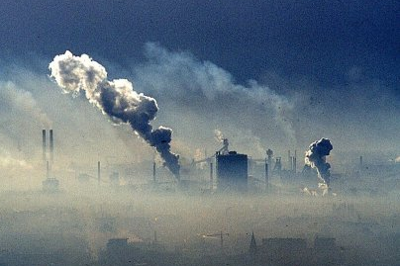
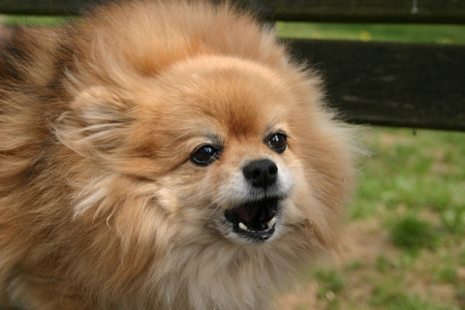
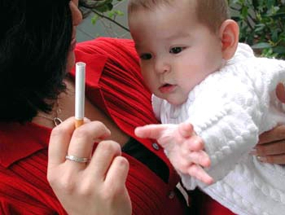

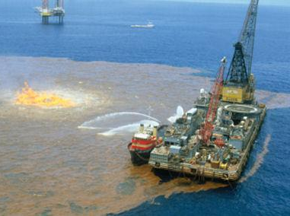
Negative Externalities
Notes:
Smog
Traffic

Slide 109
Negative Externalities
(aka: Spillover Costs)
Situation that results in a COST for a different person other than the original decision maker.
The costs “spillover” to other people or society.
Example: Zoram is a chemical company that pollutes the air when it produces its good.
Zoram only looks at its INTERNAL costs.
The firms ignores the social cost of pollution
So, the firm’s marginal cost curve is its supply curve
When you factor in EXTERNAL costs, Zoram is producing too much of its product.
The government recognizes this and limits production.

Slide 110
Market for Cigarettes
The marginal private cost doesn’t include the costs to society.
P
Supply = Marginal
Private Cost
D=MSB
Q_{Free Market}
Q

Slide 111
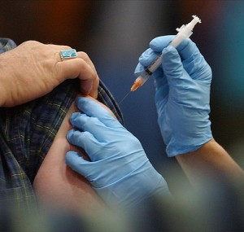
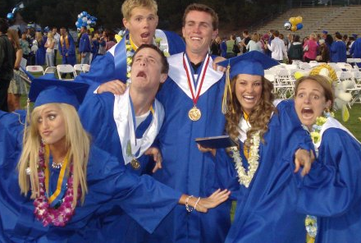
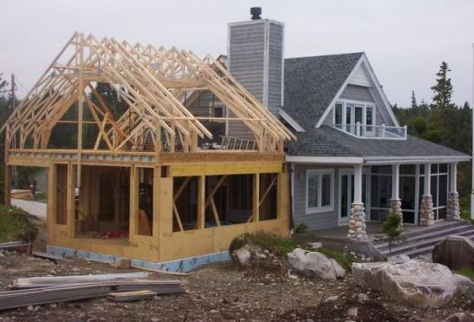
Positive Externalities

Slide 112
Positive Externalities
(aka: Spillover Benefits)
Situations that result in a BENEFIT for someone other than the original decision maker.
The benefits “spillover” to other people or society.
(EX: Flu Vaccines, Education, Home Renovation)
Example: A mom decides to get a flu vaccine for her child
Mom only looks at the INTERNAL benefits.
She ignores the social benefits of a healthier society.
So, her private marginal benefit is her demand
When you factor in EXTERNAL benefits the marginal benefit and demand would be greater.
The government recognizes this and subsidizes flu shots.

Slide 113
Review
1. What is an Externality?
When EXTERNAL benefits or external costs are on someone other than the original decision maker.
2. Why are Externalities Market Failures?
The free market fails to include external costs or external benefits.
3. Explain why the graph for a Negative Externality has two supply curves.
Two Costs: Private and Social
4. Explain why the graph for a Positive Externality has two demand curves.
Two Benefits: Private and Social

Slide 114
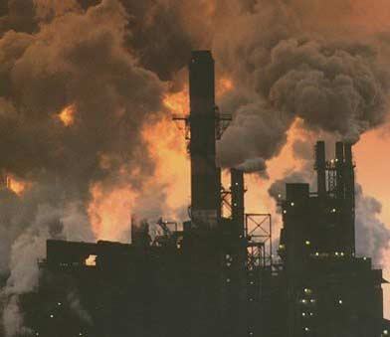
The Economics of Pollution

Slide 115
Economics of Pollution
Why are public bathrooms so gross?
The Tragedy of the Commons
(AKA: The Common Pool Problem)
Goods that are available to everyone (air, oceans, lakes, public bathrooms) are often polluted since no one has the incentive to keep them clean.
There is no monetary incentive to use them efficiently.
Result is high spillover costs.
Example: Over fishing in the ocean

Slide 116
Perverse Incentives
In 1970, the government tried to protect endangered woodpeckers by requiring land developers to report nests on their land to the EPA.
The population of these bird decreased. Why?
Assume the government wanted to limit a firm from polluting. They tell them they will inspect them twice and they must reduce pollution by 5%.
The amount of pollutants would increase. Why?
Are their “market solutions” to these problems?
Notes:
For situation one, the environmentalist can give land developers money for each nest they have. They will then have the incentive to keep the environment clean and protect the birds.
For the second situation, the government can sell the right to pollute.

Slide 117
How can markets and self interest help to limit pollution?
Government can sell the right to pollute
Assume the lake can naturally absorb 500 gallons of pollutants each year
100
The Gov’t sells each firm the right to pollute a set number of gallons
200
100
Now what does each firm have the incentive to do?
50
50
Notes:
Limit the amount they pollute and sell their excess pollution rights. No matter how much they increase output the total amount of pollutant in the lake will never go above 500. If the price goes up for the pollution rights the firms will have even a higher incentive to clean up.

Slide 118

Market Failure #3
Monopolies

Slide 119


Government in Action:
Antitrust Laws
Legislative
Executive
Judicial

Slide 120
WHAT ARE ANTITRUST LAWS?
Laws designed to prevent monopolies and promote competition.
After the Civil War, advances in technology and transportation lead to national markets.
Eventually only a few firms began to dominate industries: Railroads, Steel, meatpacking, coal, etc.
Why are monopolies a Market Failure?
Monopolies destroy the key ingredient of the free market system- Competition.
To fix this MARKET FAILURE the government must get involved.

Slide 121
WHAT DOES THE GOVERNMENT DO?
Legislative Branch
Passed laws designed to stop monopolies
Sherman Act of 1890-
  “Every person who shall monopolize …or conspire to monopolize…shall be deemed guilty of a felony.”
Executive Branch
The Federal Trade Commission must approve all corporate mergers. (Like AT&T and…)
When firms use anti-competitive tactics the Department of Justice files suit against them.
Judicial Branch
Supreme Court finds the firm guilty or not guilty and assigns a punishment.

Slide 122

Oligopolies
A few companies that control a market or particular good.
  Ex: early phone companies, early electric companies, UPS and FedEx

Slide 123
Market Failures

Slide 124
Review
Define Market Failure.
Identify the four market failures we have learned in this unit.
Explain why public goods are a market failure.
Explain why externalities are a market failure.
Explain why monopolies are a market failure.
Name 10 different super heroes.

Slide 125
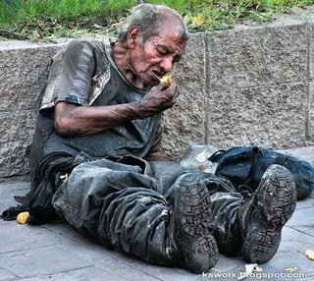
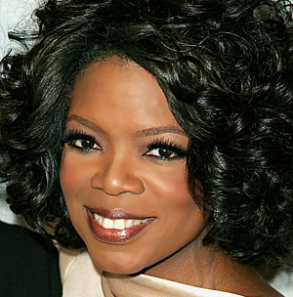
Market Failure #4
Unfair Distribution of Wealth
Net Worth over $2.3 billion

Slide 126
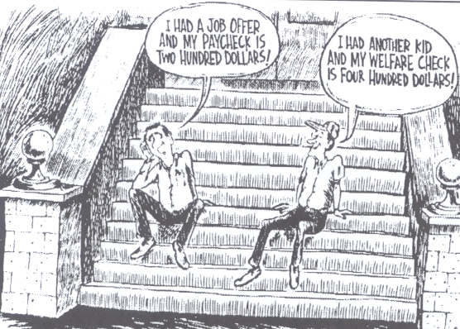
Welfare provides a safety net for citizens
(retirement, unemployment, workers comp, health, etc.)
BUT, what are some possible downsides?
Where does the government get the money for welfare?

Slide 127
Some Videos on Rich vs. Poor
Rich vs Super Rich (funny)
Distribution of income (serious)

Slide 128
Taxes

Slide 129
What are Taxes?
Taxes – mandatory payments made to the government to cover costs of governing.
Why does the government tax?
Two purposes:
Finance government operations.
  Public goods-highways, defense, employee wages
  Fund Programs- welfare, social security
2. Influence economic behavior of firms and individuals.
Ex: Excise taxes on tobacco raises tax revenue and discourages the use of cigarettes.

Slide 130
Three Types of Taxes
1. Progressive Taxes -takes a larger percent of income from high income groups (takes more from rich people).
Ex: Current Federal Income Tax system
2. Proportional Taxes (flat rate) –takes the same percent of income from all income groups.
Ex: 20% flat income tax on all income groups
3. Regressive Taxes –takes a larger percentage from low income groups (takes more from poor people).
Ex: Sales tax; any consumption tax.

Slide 131
Three Types of Taxes
What kind of taxes are these? (THINK % of Income)
Toll road tax ($1 per day)
State income tax where richer citizens pay higher %
$.45 tax on cigarettes
Medicare tax of 1% of every dollar earned
8.25% California sales tax
Notes:
Regressive
Progressive
Regressive
Proportional
Regressive

Slide 132
Federal Income Tax Debate
Equal Tax of $350 per week (Regressive Tax)
Income Amount of Tax % Amount to live on
$200 $350 175% -$150)[crime?]
$350 $350 100% $0
$500 $350 70% $150
$1,000 $350 35% $650
$5,000 $350 7% $4,650
Tax tax of 20% per week (Proportional Tax)
Income Amount of Tax Amount to live on
$200 $40 $160
$350 $70 $280
$500 $100 $400
$1,000 $200 $800
$5,000 $1,000 $4,000

Slide 133
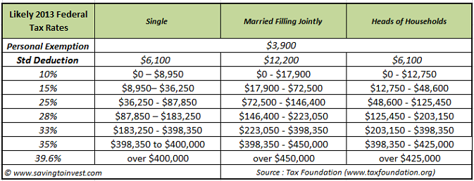
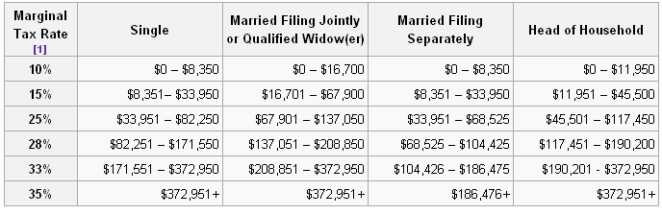
Federal Income Tax Debate
This is our current system. Is it fair?
The Progressive tax system is the most effective way to fight this market failure

Slide 134
The Laffer Curve
The LAST micro graph to learn!!!!
Shows relationship between tax rate and tax revenue.
What would happen if the highest tax bracket was 75%?
134

Slide 135
THINK ROBIN HOOD!!!!!!
What was his group’s name?
Merry Men
What did they do?
Laugh a lot…they were “Laffers.”
What was his weapon of choice?
Bow and Arrow
What did Robin Hood do?
Steal from the rich and give to the poor.
What would happen to the amount of travelers through Sherwood forest if he took 95% instead of 39% of their money?
What would happen to the total amount of money he collects?
135

Slide 136
The Laffer Curve
If the government increase taxes rates tax revenue will increase
% Tax Rate
If the tax rate becomes too high, tax revenue will fall since workers have no incentive to work harder
Tax Revenue
136

