Slide 1
Unit II: Basic Economic Concepts

Slide 2
Unit 2 Objectives
Concept 1: Foundations of Economics
PO 1. Analyze the implications of scarcity: a. limited resources and unlimited human wants influence choice at individual, national, and international levels b. factors of production (e.g., natural, human, and capital resources, entrepreneurship, technology) c. marginal analysis by producers, consumers, savers, and investors
PO 2. Analyze production possibilities curves to describe opportunity costs and trade-offs.
PO 3. Describe the characteristics of the mixed-market economy of the United States: a. property rights b. profit motive c. consumer sovereignty d. competition e. role of the government f. rational self-interest g. invisible hand (Adam Smith)
PO 4. Evaluate the economic implications of current events from a variety of sources (e.g., magazine articles, newspaper articles, radio, television reports, editorials, Internet sites).
PO 5. Interpret economic information using charts, tables, graphs, equations, and diagrams.

Slide 3
Essential Questions
Can we learn anything from Communism?
2. What are the most important factors of production, and how can we provide more of these factors within society?
3. Should the government involve itself in business and consumer matters?
4. How can people become more successful and productive in society?

Slide 4
What is Economics in General?
Economics is the science of scarcity.
Scarcity is the condition in which our wants are greater than our limited resources.
Since we are unable to have everything we desire, we must make choices on how we will use our resources.
In economics we will study the choices of individuals, firms, and governments.
Economics is the study of _________.
choices

Slide 5
Examples:
You must choose between buying jeans or buying shoes.
Businesses must choose how many people to hire
Governments must choose how much to spend on welfare.
Economics Defined
Economics-Social science concerned with the efficient use of limited resources to achieve maximum satisfaction of economic wants.
(Study of how individuals and societies deal with ________)

Slide 6
Positive vs. Normative
How is Economics used?
Economists use the scientific method to make generalizations and abstractions to develop theories. This is called theoretical economics.
These theories are then applied to fix problems or meet economic goals. This is called policy economics.
Positive Statements- Based on facts. Avoids value judgements (what is).
Normative Statements- Includes value judgements (what ought to be).

Slide 7
5 Key Economic Assumptions
Society’s wants are unlimited, but ALL resources are limited (scarcity).
Due to scarcity, choices must be made. Every choice has a cost (a trade-off).
Everyone’s goal is to make choices that maximize their satisfaction. Everyone acts in their own “self-interest.”
Everyone acts rationally by comparing the marginal costs and marginal benefits of every choice
Real-life situations can be explained and analyzed through simplified models and graphs.

Slide 8
Thinking at the Margin
# Times Watching Movie | Benefit | Cost
1st | $30 | $10
2nd | $15 | $10
3rd | $5 | $10
Total | $50 | $30
Would you see the movie three times?

Slide 9
Analyzing Choices

Slide 10
Given the following assumptions, make a rational choice in your own self-interest (hold everything else constant)…
1. You want to visit your friend for the weekend
2. You work every weekday earning $100 per day
3. You have three flights to choose from:
Thursday Night Flight = $275
Friday Early Morning Flight = $300
Friday Night Flight = $325
Which flight should you choose? Why?

Slide 11
Marginal Analysis
In economics the term marginal = additional
“Thinking on the margin”, or MARGINAL ANALYSIS involves making decisions based on the additional benefit vs. the additional cost.
For Example:
You have been shopping at the mall for a half hour, the additional benefit of shopping for an additional half-hour might outweigh the additional cost (the opportunity cost).
After three hours, the additional benefit from staying an additional half-hour would likely be less than the additional cost.

Slide 12
Trade-offs and Opportunity Cost
ALL decisions involve trade-offs.
Trade-offs are ALL the alternatives that we give up whenever we choose one course of action over others.
The most desirable alternative given up as a result of a decision is known as OPPORTUNITY COST.
Discuss:
What are trade-offs of deciding to go to college?
What is the opportunity cost of going to college?
Notes:
GEICO: The money you could be saving. In other words…what could you be doing with the money you just spent on expensive insurance?!?!?

Slide 13
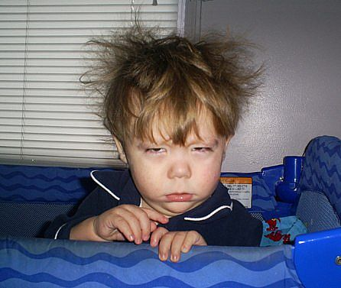
Opportunity Cost Analysis
What was the 1st decision you made this morning?

Slide 14
Opportunity Cost Analysis
YOU
Decision Maker:
Alternatives:
Perceived Benefits
Choice
Opp. Cost
Benefits Refused
Don’t Get Up Now
Get Up Now

Slide 15
Opportunity Cost Analysis
Decision Maker: YOU
Alternatives: | Get Up Now | Don’t Get Up Now
Perceived Benefits | shower bkfst don’t rush on time coffee
Choice
Opp. Cost
Benefits Refused
More sleep

Slide 16
Opportunity Cost Analysis
Decision Maker: YOU
Alternatives: | Get Up Now | Don’t Get Up Now
Perceived Benefits | shower bkfst
Choice | X
Opp. Cost
Benefits Refused
More sleep
Don’t Rush
Be on Time
X

Slide 17
Opportunity Cost Analysis
Decision Maker: YOU
Alternatives: | Get Up Now | Don’t Get Up Now
Perceived Benefits | shower bkfst don’t rush on time coffee
Choice | X
Opp. Cost |  | X
Benefits Refused | More sleep
Notes:
Picture of person in shower or walking dog

Slide 18
Opportunity Cost Analysis
Decision Maker: Grumpy
Alternatives: | Get Up Now | Don’t Get Up Now
Perceived Benefits | shower bkfst don’t rush on time coffee
Choice
Opp. Cost | X
Benefits Refused |  | shower bkfst don’t rush on time coffee
More sleep
X
Notes:
Put in picture of Grumpy dwarf

Slide 19
Minimum Wage—Good or Bad?
Again, as economists we want what is BEST for society.
Let’s not demonize everything.
Let’s strengthen our argument like a good economist:
Read the minimum wage article on Google Classroom (Pros and Cons)
Fill out the Opportunity Cost Chart

Slide 20
Opportunity Cost Analysis
Minimum Wage Decision Maker: ___________
Alternatives:
Perceived Benefits
Choice
Opp. Cost
Benefits Refused
Keep it
Get rid of it

Slide 21
Scenario
Tina has been working at Wigitflix for five years. She has spent a lot of time away from her family in order to be promoted to regional manager. She also just spent 25 thousand dollars on a business degree so she could have the proper credentials for her position. She even moved states to secure her new job. Lately, she has had some apprehensions about her new job. Tina is not happy with her co-workers. She does not like her new position very much. She works long hours. Tina really wants to quit. Your job is to justify why she should NOT quit her job! Justify your answers by referring to the scenario described above.

Slide 22
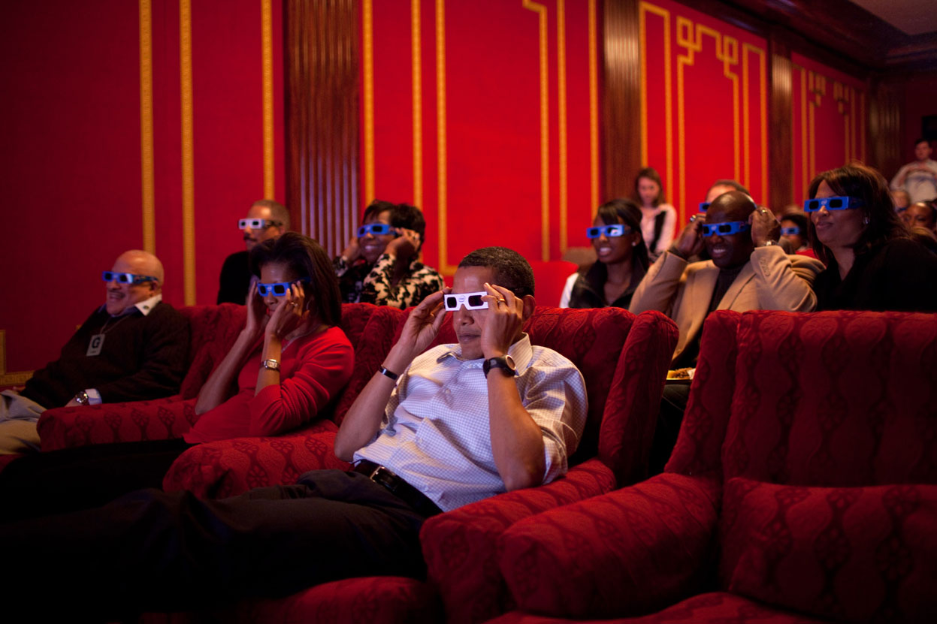
Sunk Cost Fallacy

Slide 23
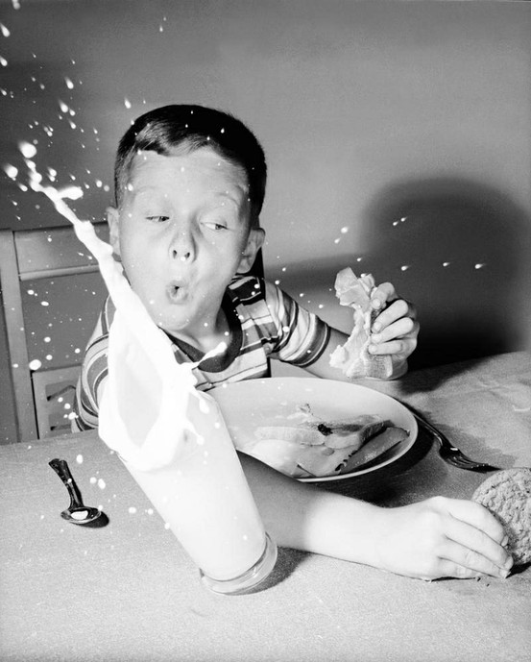
Cultural Expressions of the Sunk Cost Fallacy
“Don’t throw good money after bad.”
“It’s no use crying over spilled milk.”

Slide 24
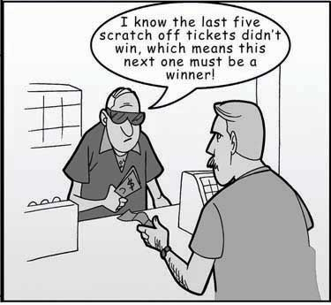
Sunk Cost Definition
In economics and business decision-making, a sunk cost is a cost that has already been incurred and cannot be recovered.

Slide 25
Google Classroom Assignment
Sunk Cost Assignment
Read
Analyze
Research

Slide 26
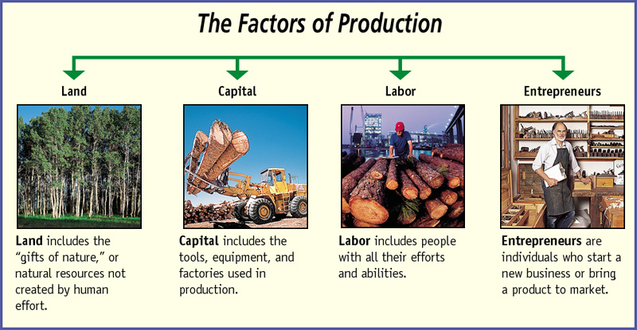
The Factors of Production
26

Slide 27
Micro vs. Macro
MICROeconomics-
Study of small economic units such as individuals, firms, and industries (competitive markets, labor markets, personal decision making, etc.)
MACROeconomics-
Study of the large economy as a whole or in its basic subdivisions (National Economic Growth, Government Spending, Inflation, Unemployment, etc.)

Slide 28
The Production Possibilities Curve (PPC)
Using Economic Models…
Step 1: Explain concept in words
Step 2: Use numbers as examples
Step 3: Generate graphs from numbers
Step 4: Make generalizations using graph
28

Slide 29
What is the Production Possibilities Curve?
A production possibilities graph (PPG) is a model that shows alternative ways that an economy can use its scarce resources
This model graphically demonstrates scarcity, trade-offs, opportunity costs, and efficiency.
4 Key Assumptions
Only two goods can be produced
Full employment of resources
Fixed Resources (Ceteris Paribus)
Fixed Technology
29

Slide 30
Production “Possibilities” Table
a
b
c
d
e
f
Bikes
14
12
9
5
0
0
Computers
0
2
4
6
8
10
Each point represents a specific combination of goods that can be produced given full employment of resources.
NOW GRAPH IT: Put bikes on y-axis and computers on x-axis
30

Slide 31
PRODUCTION POSSIBILITIES
How does the PPG graphically demonstrates scarcity, trade-offs, opportunity costs, and efficiency?
14
12
10
8
6
4
2
0
Impossible/Unattainable
(given current resources)
A
B
G
C
Bikes
Efficient
D
Inefficient/ Unemployment
E
0 2 4 6 8 10
Computers
31

Slide 32
Opportunity Cost
Example:
1. The opportunity cost of moving from a to b is…
2.The opportunity cost of moving from b to d is…
3.The opportunity cost of moving from d to b is…
4.The opportunity cost of moving from f to c is…
5.What can you say about point G?
32

Slide 33
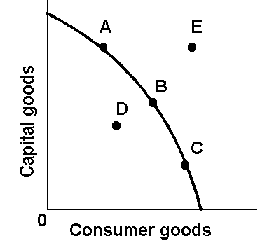
The Production Possibilities Curve (or Frontier)
33

Slide 34
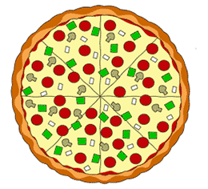
PRODUCTION POSSIBILITIES
A B C D E
CALZONES 4 3 2 1 0
PIZZA 0 1 2 3 4
List the Opportunity Cost of moving from a-b, b-c, c-d, and d-e.
Constant Opportunity Cost- Resources are easily adaptable for producing either good.
Result is a straight line PPC (not common)
34

Slide 35
PRODUCTION POSSIBILITIES
A B C D E
PIZZA 18 17 15 10 0
ROBOTS 0 1 2 3 4
List the Opportunity Cost of moving from a-b, b-c, c-d, and d-e.
Law of Increasing Opportunity Cost-
As you produce more of any good, the opportunity cost (forgone production of another good) will increase.
Why? Resources are NOT easily adaptable to producing both goods.
Result is a bowed out (Concave) PPC

Slide 36
PER UNIT Opportunity Cost
How much each marginal unit costs
= Opportunity Cost
Units Gained
Example:
1. The PER UNIT opportunity cost of moving from a to b is…
2.The PER UNIT opportunity cost of moving from b to c is…
3.The PER UNIT opportunity cost of moving from c to d is…
4.The PER UNIT opportunity cost of moving from d to e is…
NOTICE: Increasing Opportunity Costs
36

Slide 37
Shifting the Production Possibilities Curve
37

Slide 38
PRODUCTION POSSIBILITIES
4 Key Assumptions Revisited
Only two goods can be produced
Full employment of resources
Fixed Resources (4 Factors)
Fixed Technology
What if there is a change?
3 Shifters of the PPC
1. Change in resource quantity or quality
2. Change in Technology
3. Change in Trade
38

Slide 39
PRODUCTION POSSIBILITIES
What happens if there is an increase in population?
Q
14
13
12
11
10
9
8
7
6
5
4
3
2
1
Robots
Q
1 2 3 4 5 6 7 8
Pizzas
39

Slide 40
PRODUCTION POSSIBILITIES
What happens if there is an increase in population?
Q
14
13
12
11
10
9
8
7
6
5
4
3
2
1
Robots
Q
1 2 3 4 5 6 7 8
Pizzas
40

Slide 41
PRODUCTION POSSIBILITIES
Q
14
13
12
11
10
9
8
7
6
5
4
3
2
1
Technology improvements in pizza ovens
Robots
Q
1 2 3 4 5 6 7 8
Pizzas
41

Slide 42
The Production Possibilities Curve and Efficiency
42

Slide 43
Two Types of Efficiency
Productive Efficiency-
Products are being produced in the least costly way.
This is any point ON the Production Possibilities Curve
Allocative Efficiency-
The products being produced are the ones most desired by society.
This optimal point on the PPC depends on the desires of society.
43

Slide 44
Productive and Allocative Efficiency
Which points are productively efficient?
Which are allocatively efficient?
14
12
10
8
6
4
2
0
Productively Efficient points are A through D
A
B
G
Allocative Efficient points depend on the wants of society
(What if this represents a country with no electricity?)
Bikes
C
E
F
D
0 2 4 6 8 10
Computers
44

Slide 45
Capital Goods and Future Growth
Panama - FAVORS
CONSUMER GOODS
Mexico - FAVORS
CAPITAL GOODS
CURRENT
CURVE
FUTURE
CURVE
FUTURE
CURVE
Capital Goods
CURRENT
CURVE
Capital Goods
Consumer goods
Consumer goods
Panama
Mexico
45

Slide 46
PPC Practice
Draw a PPC showing changes for each of the following:
Pizza and Robots (3)
1. New robot making technology
2. Decrease in the demand for pizza
3. Mad cow disease kills 85% of cows
Consumer goods and Capital Goods (4)
4. BP Oil Spill in the Gulf
5. Faster computer hardware
6. Many workers unemployed
7. Significant increases in education
46

Slide 47
Question #1
New robot making technology
Q
Robots
Q
Pizzas
47

Slide 48
Question #2
Decrease in the demand for pizza
Q
Robots
Q
Pizzas
48

Slide 49
Question #3
Mad cow disease kills 85% of cows
Q
Robots
Q
Pizzas
49

Slide 50
Question #4
BP Oil Spill in the Gulf
Q
Capital Goods (Guns)
Q
Consumer Goods (Butter)
50

Slide 51
Question #5
Faster computer hardware
Q
Capital Goods (Guns)
Q
Consumer Goods (Butter)
51

Slide 52
Question #6
Many workers unemployed
Q
Capital Goods (Guns)
Q
Consumer Goods (Butter)
52

Slide 53
Question #7
Significant increases in education
Q
Capital Goods (Guns)
Q
Consumer Goods (Butter)
53

Slide 54
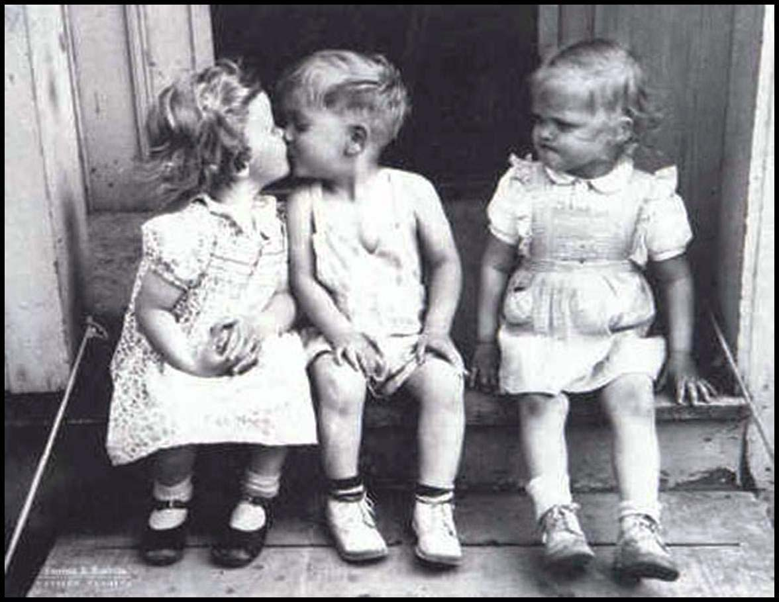
Scarcity Means There Is Not Enough For Everyone
Government must step in to help allocate (distribute) resources
54

Slide 55
The Three Economic Questions
Every society must answer three questions:
What goods and services should be produced?
How should these goods and services be produced?
Who consumes these goods and services?
The way these questions are answered determines the economic system
An economic system is the method used by a society to produce and distribute goods and services.
55

Slide 56
Economic Systems
Centrally-Planned (Command) Economy
Free Market Economy
Mixed Economy
56

Slide 57
Centrally-Planned Economies
(aka Communism)
57

Slide 58
Centrally Planned Economies
In a centrally planned economy (communism) the government…
owns all the resources.
decides what to produce, how much to produce, and who will receive it.
Examples:
Cuba, China, North Korea, former Soviet Union
Why do centrally planned economies face problems of poor-quality goods, shortages, and unhappy citizens?
NO PROFIT MEANS NO INCENTIVES!!
58

Slide 59
Advantages and Disadvantages
What is GOOD about Communism?
What is BAD about Communism?
Low unemployment-everyone has a job
Great Job Security-the government doesn’t go out of business
Equal incomes means no extremely poor people
Free Health Care
No incentive to work harder
No incentive to innovate or come up with good ideas
No Competition keeps quality of goods poor.
Corrupt leaders
Few individual freedoms
59

Slide 60
Free Market System
(aka Capitalism)
60

Slide 61
Characteristics of Free Market
Little government involvement in the economy. (Laissez Faire = Let it be)
Individuals OWN resources and answer the three economic questions.
The opportunity to make PROFIT gives people INCENTIVE to produce quality items efficiently.
Wide variety of goods available to consumers.
Competition and Self-Interest work together to regulate the economy (keep prices down and quality up).
Reword for Communism
61

Slide 62
Example of Free Market
Example of how the free market regulates itself:
If consumers want computers and only one company is making them…
Other businesses have the INCENTIVE to start making computers to earn PROFIT.
This leads to more COMPETITION….
Which means lower prices, better quality, and more product variety.
We produce the goods and services that society wants because “resources follow profits”.
The End Result: Most efficient production of the goods that consumers want, produced at the lowest prices and the highest quality.
62

Slide 63
The Invisible Hand
The concept that society’s goals will be met as individuals seek their own self-interest.
Example: Society wants fuel efficient cars…
Profit seeking producers will make more.
Competition between firms results in low prices, high quality, and greater efficiency.
The government doesn’t need to get involved since the needs of society are automatically met.
Competition and self-interest act as an invisible hand that regulates the free market.
63

Slide 64
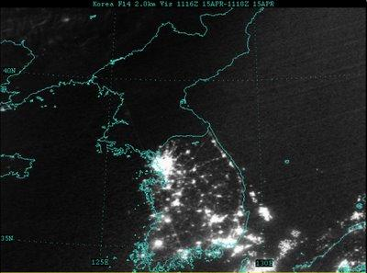
The difference between North and South Korea at night. North Korea's GDP is $40 Billion
South Korea's GDP is $1.3 Trillion (32 times greater).

Slide 65
Connection to the PPC
Communism in the Long Run
Free Markets in the Long Run
CURRENT
CURVE
FUTURE
CURVE
FUTURE
CURVE
Capital Goods
CURRENT
CURVE
Capital Goods
Consumer goods
Consumer goods
Cuba
Puerto Rico
65

Slide 66
The Circular Flow Model
66

Slide 67
Locate supply and demand in the Product Market Supply and Demand

Slide 68
DEMAND
Resource Market
SUPPLY
$$$ Costs $$$
$$$ Income $$$
Resources
Resources
(Factors of
Production)
Businesses
Individuals
Goods and
Services
Goods and
Services
$$$ Spending $$$
$$$ Revenue $$$
SUPPLY
Product Market
DEMAND
68

